Slide 1
Ch7: Instruction Pipeline
指令流水线
第一讲 流水线数据通路和控制逻辑
第二讲 流水线冒险处理
第三讲 高级流水线技术
Notes:
Start X:40流水线处理器中，指令重叠执行
流水线中，每条指令的执行被划分成相同多个阶段
每个流水段的执行时间相等，都在一个周期内完成
流水线中，多个指令可能同时需要用同一个部件
流水线中，转移指令或异常事件会破坏流水线的执行
流水线中，指令数据相关时也可能破坏流水线的执行

Slide 2
第一讲 流水线数据通路和控制
主 要 内 容
日常生活中的流水线处理例子：洗衣服
单周期处理器模型和流水线性能比较
什么样的指令集适合于流水线方式执行
如何设计流水线数据通路
  以MIPS指令子集来说明
  详细设计取指令部件
  详细设计执行部件
  分析每条指令在流水线中的执行过程，遇到各种问题：
    资源冲突
    寄存器和存储器的信号竞争
    分支指令的延迟
    指令间数据相关
如何设计流水线控制逻辑
  分析每条指令执行过程中的控制信号
  给出控制器设计过程
流水线冒险的概念

Slide 3
复习：A Single Cycle Processor
Branch
<31:26>
RegDst
Jump
Instruction<31:0>
op
Main
Control
ALUSrc
Instruction
Fetch Unit
:
Zero
<16:20>
<0:15>
<21:25>
Clk
<11:15>
ALUop
3
Rd
Rt
Rd
<5:0>
ALU
Control
RegDst
Imm16
1
Mux
0
func
Rs
Rt
3
RegWr
5
5
5
ALUctr
busA
MemWr
MemtoReg
Rw
Ra
Rb
Zero
busW
32
32 32-bit
Registers
ALU
0
32
busB
0
32
Clk
32
Mux
Mux
32
WrEn
Adr
1
1
Data In
32
imm16
Extender
Data
Memory
16
32
Instr<15:0>
Clk
ALUSrc
ExtOp
Notes:
I like to start today’s lecture with a look back at the single cycle processor.
The reason is that this single cycle processor has a lot of common with the pipeline processor we are going to talk about today.
Everything in this single cycle processor starts at the Instruction Fetch Unit which sends the Rs, Rt, Rd, and Immediate fields of the instruction to the datapath.
At the same time, the Opcode and Func fields of the instruction are sent to the Control Unit.
Based on the OP field of the instruction, the Main Control will set the control signals RegDst, ALUSrc, .... etc. properly.
The ALU Control then uses the ALUop from the Main control and the Func field of the instruction to generate the ALUctr signals to ask the ALU to do the right thing.
As far as the datapath is concerned, the data pretty much flow from left to right.
+1 = 1 min. (X:41)
Question: Why do we say that single cycle processor has more commonplaces with pipeline processor?

Slide 4
复习：Multiple Cycle Processor
MCP: 一个功能部件在一个指令周期中可以被使用多次。
PCWr
PCWrCond
PCSrc
BrWr
Zero
IorD
MemWr
IRWr
RegDst
RegWr
ALUSelA
1
Target
Mux
32
32
PC
32
0
0
Zero
Rs
Mux
0
Ra
32
Mux
RAdr
Rt
5
busA
32
32
Rb
1
ALU
32
Ideal
Memory
Instruction Reg
5
Reg File
32
1
Rt
0
4
0
WrAdr
32
Mux
Rw
busB
32
32
Din
Dout
Rd
busW
32
1
32
32
1
2
1
Mux
0
3
ALU
Control
<< 2
Imm
Extend
16
32
ALUOp
ExtOp
MemtoReg
ALUSelB
Notes:
And here it is the datapath of the multiple cycle processor.
As we said earlier, one advantage of this Multiple Cycle implementation is that a functional unit can be used more than once per instruction AS LONG it is used at different cycles.
For example, the ALU here is used for calculating the next PC as well as all the others ALU operations and the Ideal Memory here is used for storing the instruction as well as data
The explicit price we pay for using a functional unit more than once per instruction are all the extra MUXes we need in the datapath.
The implicit price we pay is lower performance because as I will show you today, by NOT using a functional unit more than once per instruction, we can pipeline the instructions and achieve MUCH higher performance.
+1 = 45 min. (X:45)

Slide 5
复习：Timing Diagram of a Load Instruction
Instruction Fetch
Instr Decode /
Address
Data Memory
Reg Wr
Reg. Fetch
Clk
Clk-to-Q
PC
Old Value
New Value
Instruction Memory Access Time
Rs, Rt, Rd,
Op, Func
Old Value
New Value
1
Delay through Control Logic
ALUctr
Old Value
New Value
ExtOp
Old Value
New Value
ALUSrc
Old Value
New Value
RegWr
Old Value
New Value
2
Register File Access Time
busA
Old Value
New Value
Register File Write Time
Delay through Extender & Mux
3
busB
Old Value
New Value
ALU Delay
Address
Old Value
New Value
Data Memory Access Time
busW
Old Value
New
Notes:
Well let’s take a look at the Load instruction’s timing diagram and see how we can break it up into smaller steps. The biggest contributors to the cycle time appears to be:
(1) Instruction Memory Access Time.
(2) Delay through the Control Logic, which happens in parallel with Register File Access.
(3) ALU Delay.
(4) Data Memory Access Time.
(5) And Register File Write Time.
Therefore, it makes sense to break up the Load instructions into these five steps:
(1) Instruction Fetch.
(2) Instruction Decode “slash” Register Fetch.
(3) Memory Address Calculation.
(4) Data Memory Access.
(5) And finally, Register File Write.
Notice that here I have used the term Register File Write time instead of Register File Write Setup time. The reason is that in a “real” register file, there is no such thing as set up time.
+2 = 13 min. (X:53)

Slide 6
一个日常生活中的例子—洗衣服
Laundry Example
  Ann, Brian, Cathy, Dave
  each have one load of clothes to wash, dry, and fold
  Washer takes 30 minutes
  Dryer takes 40 minutes
  “Folder” takes 20 minutes
A
B
C
D
如果让你来管理洗衣店，你会如何安排？
Pipelining: It’s Natural !

Slide 7
Sequential Laundry（串行方式）
6 PM
7
8
9
10
11
Midnight
Time
30
40
20
30
40
20
30
40
20
30
40
20
T
a
s
k
O
r
d
e
r
A
B
C
D
串行方式下， 4 批衣服需要花费 6 小时（4x(30+40+20)=360分钟）
N批衣服，需花费的时间为Nx(30+40+20) = 90N
如果用流水线方式洗衣服，则花多少时间呢?

Slide 8
Pipelined Laundry: (Start work ASAP)
6 PM
7
8
9
10
11
Midnight
Time
30
40
40
40
40
20
T
a
s
k
O
r
d
e
r
串行为6小时，N批则为90N分钟
A
流水线方式下，需30+4x40+20
=210分 (3.5小时)
如果有N批衣服呢？
30+Nx40+20分钟
假定每一步时间均衡，则比串行方式提高约3倍！
B
C
D
流水方式下，所用时间主要与最长阶段的时间有关！

Slide 9
复习：Load指令的5个阶段
阶段1
阶段2
阶段 3
阶段 4
阶段5
Ifetch
Reg/Dec
Exec
Mem
Wr
Ifetch (取指) : 取指令并计算PC+4 (用到哪些部件？)
Reg/Dec (取数和译码) : 取数同时译码 (用到哪些部件？)
Exec (执行) : 计算内存单元地址 (用到哪些部件？)
Mem (读存储器) : 从数据存储器中读 (用到哪些部件？)
Wr(写寄存器): 将数据写到寄存器中 (用到哪些部件？)
  指令存储器、Adder
寄存器堆读口、指令译码器
这里寄存器堆的读口和写口可看成两个不同的部件。
扩展器、ALU
数据存储器
寄存器堆写口
指令的执行过程是否和“洗衣”过程类似？是否可以采用类似方式来执行指令呢？
Notes:
As shown here, each of these five steps will take one clock cycle to complete.
And in pipeline terminology, each step is referred to as one stage of the pipeline.
+1 = 8 min. (X:48)

Slide 10
单周期指令模型与流水线性能
假定以下每步操作所花时间为：
    取指：2ns
    寄存器读：1ns
    ALU操作：2ns
    存储器读：2ns
    寄存器写：1ns
单周期模型
  每条指令在一个时钟周期内完成
  时钟周期等于最长的lw指令的执行时间，即：8ns
  串行执行时，N条指令的执行时间为：8Nns
流水线性能
  时钟周期等于最长阶段所花时间为：2ns
  每条指令的执行时间为： 2nsx5=10ns
  N条指令的执行时间为：(4+N)x2ns
  在N很大时，比串行方式提高约 4 倍
  若各阶段操作均衡(例如，各阶段都是2ns)，则提高倍数为5倍。
Load指令执行时间总计为：8ns
(假定控制单元、PC访问、信号传递等没有延迟)
流水线方式下，单条指令执行时间不能缩短，但能大大提高指令吞吐率！

Slide 11
流水线指令集的设计
具有什么特征的指令集有利于流水线执行呢？
  长度尽量一致，有利于简化取指令和指令译码操作
    MIPS指令32位，下址计算方便: PC+4
    X86指令从1字节到17字节不等，使取指部件及其复杂
  格式少，且源寄存器位置相同，有利于在指令未知时就可取操作数
    MIPS指令的Rs和Rt位置一定，在指令译码时就可读Rs和Rt的值
    （若位置随指令不同而不同，则需先确定指令后才能取寄存器编号）
  load / Store指令才能访问存储器，有利于减少操作步骤，规整流水线
    lw/sw指令的地址计算和运算指令的执行步骤规整在同一个周期
    X86运算类指令操作数可为内存数据，需计算地址、访存、执行
  内存中”对齐”存放，有利于减少访存次数和流水线的规整
  总之，规整、简单和一致等特性有利于指令的流水线执行
流水线执行方式能大大提高指令吞吐率，现代计算机都采用流水线方式！

Slide 12
Load指令的流水线
Cycle 1
Cycle 2
Cycle 3
Cycle 4
Cycle 5
Cycle 6
Cycle 7
Clock
1st lw
Ifetch
Reg/Dec
Exec
Mem
Wr
2nd lw
Ifetch
Reg/Dec
Exec
Mem
Wr
3rd lw
Ifetch
Reg/Dec
Exec
Mem
Wr
每个周期有五个功能部件同时在工作
后面指令在前面完成取指后马上开始
每个load指令仍然需要五个周期完成
但是吞吐率(throughput)提高许多，理想情况下，有：
  每个周期有一条指令进入流水线
  每个周期都有一条指令完成
  每条指令的有效周期(CPI)为1
Notes:
For the load instructions, the five independent functional units in the pipeline datapath are:
(a) Instruction Memory for the Ifetch stage.
(b) Register File’s Read ports for the Reg/Decode stage.
(c) ALU for the Exec stage. (d) Data memory for the Mem stage.
(e) And finally Register File’s write port for the Write Back stage.
Notice that I have treated Register File’s read and write ports as separate functional units because the register file we have allows us to read and write at the same time.
Notice that as soon as the 1st load finishes its Ifetch stage, it no longer needs the Instruction Memory. Consequently, the 2nd load can start using the Instruction Memory (2nd Ifetch).
Furthermore, since each functional unit is only used ONCE per instruction, we will not have any conflict down the pipeline (Exec-Ifet, Mem-Exec, Wr-Mem) either.
I will show you the interaction between instructions in the pipelined datapath later. But for now, I want to point out the performance advantages of pipelining.
If these 3 load instructions are to be executed by the multiple cycle processor, it will take 15 cycles. But with pipelining, it only takes 7 cycles. This (7 cycles), however, is not the best way to look at the performance advantages of pipelining.
A better way to look at this is that we have one instruction enters the pipeline every cycle so we will have one instruction coming out of the pipeline (Wr stages) every cycle.
Consequently, the “effective” (or average) number of cycles per instruction is now ONE even though it takes a total of 5 cycles to complete each instruction.
+3 = 14 min. (X:54)

Slide 13
R-type指令的4个阶段
Cycle 1
Cycle 2
Cycle 3
Cycle 4
R-type
Ifetch
Reg/Dec
Exec
Wr
Ifetch: 取指令并计算PC+4
Reg/Dec: 从寄存器取数，同时指令在译码器进行译码
Exec: 在ALU中对操作数进行计算
Wr: ALU计算的结果写到寄存器
Notes:
Well, so far so good. Let’s take a look at the R-type instructions.
The R-type instruction does NOT access data memory so it only takes four clock cycles, or in our new pipeline terminology, four stages to complete.
The Ifetch and Reg/Dec stages are identical to the Load instructions. Well they have to be because at this point, we do not know we have a R-type instruction yet.
Instead of calculating the effective address during the Exec stage, the R-type instruction will use the ALU to operate on the register operands.
The result of this ALU operation is written back to the register file during the Wr back stage.
+1 = 15 min. (55)

Slide 14
含R-type和 Load 指令的流水线
Cycle 1
Cycle 2
Cycle 3
Cycle 4
Cycle 5
Cycle 6
Cycle 7
Cycle 8
Cycle 9
Clock
R-type
Ifetch
Reg/Dec
Exec
Wr
Ops! We have a problem!
R-type
Ifetch
Reg/Dec
Exec
Wr
Load
Ifetch
Reg/Dec
Exec
Mem
Wr
R-type
Ifetch
Reg/Dec
Exec
Wr
R-type
Ifetch
Reg/Dec
Exec
Wr
上述流水线有个问题: 两条指令试图同时写寄存器，因为
  Load在第5阶段用寄存器写口
  R-type在第4 阶段用寄存器写口
把一个功能部件同时被多条指令使用的现象称为结构冒险(Struture Hazard)
为了流水线能顺利工作，规定：
  每个功能部件每条指令只能用一次（如：写口不能用两次或以上）
  每个功能部件必须在相同的阶段被使用（如：写口总是在第五阶段被使用）
或称为资源冲突！
可以用以下两种方法解决上述结构冒险问题！
Notes:
What happened if we try to pipeline the R-type instructions with the Load instructions?
Well, we have a problem here!!!
We end up having two instructions trying to write to the register file at the same time!
Why do we have this problem (the write “bubble”)?
Well, the reason for this problem is that there is something I forget to tell you.
+1 = 16 min. (X:56)

Slide 15
解决方案1: 在流水线中插入“Bubble”（气泡）
Cycle 1
Cycle 2
Cycle 3
Cycle 4
Cycle 5
Cycle 6
Cycle 7
Cycle 8
Cycle 9
Clock
Ifetch
Reg/Dec
Exec
Wr
Load
Ifetch
Reg/Dec
Exec
Mem
Wr
R-type
Ifetch
Reg/Dec
Exec
Wr
Wr
Ifetch
Reg/Dec
Exec
Exec
Wr
R-type
Pipelin
Wr
R-type
Ifetch
Bubble
Reg/Dec
Exec
Wr
Reg/Dec
Exec
Wr
Ifetch
Ifetch
Reg/Dec
Exec
Reg/Dec
Exec
插入“Bubble”到流水线中，以禁止同一周期有两次写寄存器。缺点：
  控制逻辑复杂
  第5周期没有指令被完成（CPI不是1，而实际上是2）
方案不可行！
Notes:
The first solution is to insert a “bubble” into the pipeline AFTER the load instruction to push back every instruction after the load that are already in the pipeline by one cycle.
At the same time, the bubble will delay the Instruction Fetch of the instruction that is about to enter the pipeline by one cycle.
Needless to say, the control logic to accomplish this can be complex.
Furthermore, this solution also has a negative impact on performance.
Notice that due to the “extra” stage (Mem) Load instruction has, we will not have one instruction finishes every cycle (points to Cycle 5).
Consequently, a mix of load and R-type instruction will NOT have an average CPI of 1 because in effect, the Load instruction has an effective CPI of 2.
So this is not that hot an idea Let’s try something else.
+2 = 19 min. (X:59)

Slide 16
解决方案2: R-type的Wr操作延后一个周期执行
NOOP!
1
2
3
4
5
R-type
Ifetch
Reg/Dec
Exec
Mem
Wr
加一个NOP阶段以延迟“写”操作:
  把“写”操作安排在第5阶段, 这样使R-Type的Mem阶段为空NOP
Clock
Cycle 1
Cycle 2
Cycle 3
Cycle 4
Cycle 5
Cycle 6
Cycle 7
Cycle 8
Cycle 9
R-type
Ifetch
Reg/Dec
Exec
Mem
Wr
R-type
Ifetch
Reg/Dec
Exec
Mem
Wr
Load
Ifetch
Reg/Dec
Exec
Mem
Wr
R-type
Ifetch
Reg/Dec
Exec
Mem
Wr
R-type
Ifetch
Reg/Dec
Exec
Mem
Wr
这样使流水线中的每条指令都有相同多个阶段!
Notes:
Well one thing we can do is to add a “Nop” stage to the R-type instruction pipeline to delay its register file write by one cycle.
Now the R-type instruction ALSO uses the register file’s witer port at its 5th stage so we eliminate the write conflict with the load instruction.
This is a much simpler solution as far as the control logic is concerned. As far as performance is concerned, we also gets back to having one instruction completes per cycle.
This is kind of like promoting socialism: by making each individual R-type instruction takes 5 cycles instead of 4 cycles to finish, our overall performance is actually better off.
The reason for this higher performance is that we end up having a more efficient pipeline.
+1 = 20 min. (Y:00)

Slide 17
Store指令的四个阶段
Cycle 1
Cycle 2
Cycle 3
Cycle 4
NOOP!
Store
Ifetch
Reg/Dec
Exec
Mem
Wr
Ifetch：取指令并计算PC+4
Reg/Dec： 从寄存器取数，同时指令在译码器进行译码
Exec：16位立即数符号扩展后与寄存器值相加，计算主存地址
Mem：将寄存器读出的数据写到主存
Wr: 加一个空的写阶段，使流水线更规整！
Notes:
Let’s continue our lecture by looking at the store instruction.
Once again, the Ifetch and Reg/Decode stages are the same as all other instructions.
The Exec stage of the store instruction calculates the memory address.
Once the address is calculated, the store instruction will write the data it read from the register file back at the Reg/Decode stage into the data memory during the Mem stage.
Notice that unlike the load instruction which takes five cycles to accomplish its task, the Store instruction only takes four cycles or four pipe stages.
In order to keep our pipeline diagram looks more uniform, however, we will keep the Wr stage for the store instruction in the pipeline diagram.
But keep in mind that as far as the pipelined control and pipelined datapath are concerned, the store instruction requires NOTHING to be done once it finishes its Mem stage.
+2 = 27 min. (Y:07)

Slide 18
Beq的四个阶段
Cycle 1
Cycle 2
Cycle 3
Cycle 4
NOOP!
Beq
Ifetch
Reg/Dec
Exec
Mem
Wr
与多周期通路有什么不同？
Ifetch: 取指令并计算PC+4
Reg/Dec:从寄存器取数，同时指令在译码器进行译码
Exec: 执行阶段
  ALU中比较两个寄存器的大小（做减法）
  Adder中计算转移地址
Mem: 如果比较相等, 则：
  转移目标地址写到PC
多周期通路中，在Reg/Dec阶段投机进行了转移地址的计算！可以减少Branch指令的时钟数
为什么流水线中不进行“投机”计算？
Wr: 加一个空写阶段，使流水线更规整！
因为，流水线中所有指令的执行阶段一样多，Branch指令无需节省时钟，因为有比它更复杂的指令。
按照上述方式，把所有指令都按照最复杂的“load”指令所需的五个阶段来划分，不需要的阶段加一个“NOP”操作
Notes:
Well similar to the store instruction, the branch instruction only consists of four pipe stages.
Ifetch and Reg/decode are the same as all other instructions because we do not know what instruction we have at this point. We have not finish decoding the instruction yet.
During the Execute stage of the pipeline, the BEQ instruction will use the ALU to compare the two register operands it fetched during the Reg/Dec stage.
At the same time, a separate adder is used to calculate the branch target address.
This is difference from M-cycle processor where target address is calculated by ALU but at the 2nd cycle.
If the registers we compared during the Execute stage (point to the last bullet) have the same value, the branch is taken.
That is, the branch target address we calculated earlier (last bullet) will be written into the Program Counter.
Once again, similar to the Store instruction, the BEQ instruction will require NEITHER the pipelined control nor the pipelined datapath to do ANY thing once it finishes its Mem stage.
With all these talk about pipelined datapath and pipelined control, let’s take a look at how the pipelined datapath looks like.
+2 = 29 min. (Y:09)

Slide 19
A Pipelined Datapath（五阶段流水线数据通路）
Clock-to-Q delay
Clk
Ifetch (IF)
Reg/Dec (ID)
Exec (Ex)
Mem
Wr
有！寄存器写口
RegWr
ExtOp
ALUOp
Branch
1
0
Wr阶段没有DataPath吗？
PC+4
PC+4
PC
PC+4
Imm
Imm
Rs
busA
Zero
Data
Mem
A
Ra
busB
IUnit
Rb
Exec
Unit
RA
Do
IF/ID Register
Ex/Mem Register
Mem/Wr Register
Rt
ID/Ex Register
1
RFile
WA
Mux
Rw
Di
Rt
Di
0
0
I
Rd
1
为什么需要这些Reg？
保存每个周期执行的结果!
属于内部寄存器，对程序员透明，不需作为现场保存
RegDst
ALUSrc
MemWr
MemtoReg
下面看一下每条指令在流水线通路中的执行过程
Notes:
The pipelined datapath consists of combination logic blocks separated by pipeline registers. If you get rid of all these registers (not the PC), this pipelined datapath is reduced to the single-cycle datapath.
This should give you extra incentive to do a good job on your single cycle processor design homework because you can build your pipeline design based on your single cycle design.
Anyway, the registers mark the beginning and the end of a pipe stage.
In the multiple clock cycle lecture, I recommended that the best way to think about a logic clock cycle is that it begins slightly after the clock tick and ends right at the next clock tick.
For example here, the Reg/Decode stage begins slightly after this clock tick when the output of the IF/ID register has stabilized to its new value AND ends RIGHT at the next clock tick when the output of the register file is clocked into the ID/Exec register.
At the end of the Reg/Decode stage, the register output that just clocked into the ID/Exec register has NOT yet propagate to the register output yet. It takes a Clk-to-Q delay.
When the new value we just clocked in (points to the clock tick) has propagate to the register output, then we have reach the beginning of the Exec stage.
Notice that the Wr stage of the pipeline starts here (last cycle) but there is no corresponding datapath underneath it because the Wr stage of the pipeline is handled by the same part of the pipeline that handles the Register Read stage.
This part of the datapath (Reg File) is the only part that is used by more than one stage of the pipeline. This is OK because the register file has independent Read and Write ports.
More specifically, the Reg/Decode stage of the pipeline uses the register file’s read port while the Write Back stage of the pipeline uses the register file’s write port.
+3 = 32 min. (Y:12)

Slide 20
取指令（Ifetch) 阶段
第10单元指令: lw $1, 0x100($2) 功能：$1 <- Mem [($2) + 0x100]
You are here!
Clk
Ifetch
Reg/Dec
Exec
Mem
RegWr
ExtOp
ALUOp
Branch
1
0
PC+4
PC+4
PC+4
Imm
Imm
PC = 14
Rs
busA
Zero
Data
Mem
A
Ra
busB
IF/ID: lw $1, 100 ($2)
Exec
Unit
RA
Do
IUnit
Rb
Ex/Mem Register
Mem/Wr Register
Rt
ID/Ex Register
1
RFile
WA
Mux
Rw
Di
Di
Rt
0
0
I
Rd
1
下一目标：设计IUnit
RegDst
ALUSrc
MemWr
MemtoReg
有谁发现这里有一个假设有问题？
MIPS指令的地址可能是10吗？
Notes:
Let’s follow a Load instruction down the pipeline and see how everything works.
Every instruction starts at the Instruction Fetch stage which:
(a) Begins slightly after the first clock tick when PC output has stabilized to its new value.
(b) And ends when the output of the I-Unit is clocked into the IF/ID register.
This picture shows the state of the pipeline at the end of the Ifetch stage (you are here).
Let’s expand this part of the datapath and take a better look.
+1 = 33 min. (Y:13)

Slide 21
指令部件 IUnit的设计
第10单元指令: : lw $1, 0x100($2) 随后的指令在14号单元中！
指令部件功能
You are here!
Instr <- Mem[PC]
PC<- PC+4
Clk
Ifetch
Reg/Dec
开始从14号单元取指令！
1
0
这里MUX的控制信号由其他阶段产生！
“4”
流水段寄存器用来存放各阶段的执行结果
总是在下个时钟到来后的Clock-to-Q写入
Adder
PC = 14
10
IF/ID: lw $1, 100 ($2)
Address
PC 新值（14） ≠旧输出（10）
Instruction
Memory
应把哪些信息存到流水段寄存器IF/ID中？
Instruction
应保存后面阶段用到的指令和PC+4的值！
取指阶段有哪些控制信号？
不需控制信号，因为每条指令执行功能一样，是确定的，无需根据指令的不同来控制执行不同的操作！
指令在随后阶段被送出译码！
PC+4用来计算转移目标地址！
Notes:
Let’s assume the Load instruction we are following is in memory location TEN, 10.
So the Ifetch stage begins shortly after the first clock tick when the value 10 appears on the Program Counter register output.
This is used as the address to access the Instruction Memory and at the same time it is fed to the adder so it can be increment by four.
At the end of the Ifetch stage, this clock tick will clock the output of the instruction memory, which is the Load instruction, into the If/ID pipeline register.
As the same time, the PC plus 4 value, that is 14 in this case, will be clocked into the PC.
Notice that the picture here shows the stage of the pipeline at the END of the Ifetch stage (you are here) so the number 14, even though is already latched into the register, will not appear at the PC output until Clk-to-Q time later.
Similarly, the load instruction we just clocked into the IF/ID register will NOT appear at the register output until a Clk-toQ delay after this clock.
And when it appears at the IF/iD register output, we will be in the Reg/Decode stage.
+2 = 35 min. (Y:15)

Slide 22
译码/取数（Reg/Dec）阶段
Location 10: lw $1, 0x100($2) 功能：$1 <- Mem[($2) + 0x100]
You are here!
Clk
Ifetch
Reg/Dec
Exec
Mem
RegWr
ExtOp
ALUOp
Branch
1
0
PC+4
PC+4
PC
PC+4
IF/ID:
Imm
Imm
Rs
busA
Zero
Data
Mem
A
Ra
busB
ID/Ex: Reg. 2 & 0x100
IUnit
Rb
Exec
Unit
RA
Do
Ex/Mem Register
Mem/Wr Register
指令还要存ID/EX中吗？
不要，只要存相关信息
Rt
1
RFile
WA
Mux
Rt
Rw
Di
Di
I
0
0
Rd
1
Reg[Rs],Reg[Rt],Rt,Rd,Imm16,PC+4等被保存在ID/EXE中
RegDst
ALUSrc
MemWr
MemtoReg
该阶段有哪些控制信号？
没有！因是所有指令的公共操作，故无控制信号！
Notes:
This picture shows the state of the pipeline at the end of Load’s Reg/Decode stage.
All the datapath has to do is read register (Ra and busA) R2 from the register file.
As the same time, we need to pass the Immediate field of the instruction onto the next stage (ID/Exec) register because the immediate field is needed for address calculation.
Let’s concentrate on the load instruction (point to the 1st bullet) going down the pipe and ignore what is in the PC and IF/ID registers for now.
Since we are here (Your are Here), Register R2 and Imm16 have already clocked into ID/Exec register but they have not yet appeared at the register’s output.
+1 = 36 min. (Y:16)

Slide 23
Load指令的地址计算阶段
Location 10: lw $1, 0x100($2) 功能：$1 <- Mem[($2) + 0x100]
指令已被译码，可确定执行部件的控制信号！
You are here!
Clk
Ifetch
Reg/Dec
Exec
Mem
ALUOp=？
RegWr
ExtOp=？
Branch
1
0
PC+4
PC+4
PC
PC+4
IF/ID:
Imm
Imm
Rs
busA
Zero
Data
Mem
A
Ra
busB
Rb
Exec
Unit
RA
IUnit
Ex/Mem: Load’s Address
Do
ID/Ex Register
Mem/Wr Register
Rt
1
RFile
WA
Mux
Rt
Rw
Di
Di
I
0
0
Rd
1
如果目的寄存器Rt不传递下去，会怎样？
其他指令的Rt作为目的地址，指令执行错误！
RegDst=0
ALUSrc=？
MemWr
MemtoReg
下一目标：设计执行部件(Exec Unit)
Notes:
If we wait a little bit longer (beginning of Exe), Register R2 and Imm16 will appear at the ID/Exec register output and we are now in the Exec stage where we will calculate the Memory Address for the load instruction.
Notice that besides calculating the Load’s Memory Address, we also need to pass the Rt field (RegDst = 0) of the instruction down the pipeline.
The reason is that we will need to use Rt field later on to specify which register to write to when we reach the end of the Load pipeline.
Also notice that this is the first stage of the pipeline that requires any control signals.
We will talk more about this (Rt field and other control signals) later but for now, let’s expand this part of the datapath and take a closer look at what is going on.
+2 = 38 min. (Y:18)

Slide 24
执行部件（Exec Unit）的设计
执行部件功能？
计算内存地址
计算转移目标地址
一般ALU运算
You are here!
Clk
Exec
Mem
Adder用于计算分支指令的转移地址
Load指令的各控制信号取值？
<< 2
Target
RegDes=0, ALUSrc=1 ALUop=add, Extop=1
Adder
32
PC+4
Store指令呢？
busA
32
ID/Ex Register
32
Zero
RegDes=x, ALUSrc=1 ALUop=abb, Extop=1
Ex/Mem: Load’s Memory Address
busB
ALU
ALUout
0
32
Branch指令呢？
32
Mux
RegDes=x, ALUSrc=0 ALUop=sub, Extop=1
imm
3
ALUctr
Extender
1
16
32
ALU
Ori指令呢？
Control
ExtOp=?
ALUSrc=?
3
RegDes=0, ALUSrc=1 ALUop=or, Extop=0
ALUOp=?
R型指令呢？
RegDes=1, ALUSrc=0 ALUop=‘func’, Extop=x
Notes:
At the beginning of the Exec cycle, ID/Exec register’s output will be stabilized to Register R2 (bus A) and Imm16.
By setting the control signals ExtOp and ALUSrc to 1s, the 16-bit immediate field will be sign extended to 32 bits and pass onto the ALU.
The ALU then add (ALUOp = Add) this sign extended version of the Immediate field to Register 2 (busA) to form the memory address.
By the end of the Exec cycle (you are here), the ALU output will be valid and will be stored into the Exec/Mem pipeline register.
This Memory Address (Exec/Mem) will appear at the output of the Exec/Mem register a Clk-to-Q time after this clock tick (you are here).
+1 = 39 min. (Y:19)

Slide 25
Load指令的存储器读(Mem)周期
Location 10: lw $1, 0x100($2) 功能： $1 <- Mem[($2) + 0x100]
You are here!
Clk
Ifetch
Reg/Dec
Exec
Mem
RegWr
ExtOp
ALUOp
Branch=0
1
0
PC+4
PC+4
PC
PC+4
IF/ID:
Imm
Imm
Rs
busA
Zero
Data
Mem
A
Ra
busB
Rb
Exec
Unit
RA
Do
IUnit
ID/Ex Register
Ex/Mem Register
Mem/Wr: Load’s Data
Rt
1
RFile
WA
Mux
Rw
Di
Di
Rt
0
0
I
比较洗衣流水线，指令流水线有什么不同？
Rd
1
洗衣流程不能反向进行，但
RegDst
ALUSrc
MemWr=0
MemtoReg
该阶段有反向数据流，可能会引起冒险！以后介绍。
周期以最长操作为准设计Cycle > T_{read}
Notes:
And it will be used to read the Data Memory (RA).
By setting the clock cycle time longer than the data memory read access time, we can guarantee the memory output (Do) will be stable by the end of the Mem cycle (you are here).
And this clock tick will trigger the Mem/Wr register to latch in Load’s data.
We have to pass the Load instruction’s Rt field down the pipeline one more time because we still have not use it yet.
+1 = 40 min. (Y:20)

Slide 26
Load指令的回写（Write Back）阶段
Location 10: lw $1, 0x100($2) 功能：$1 <- Mem[($2) + 0x100]
Clk
Ifetch
Reg/Dec
Exec
Mem
Wr
RegWr=1
ExtOp
ALUOp
Branch
1
0
PC+4
PC+4
PC
PC+4
IF/ID:
Imm
Imm
Rs
busA
Zero
Data
Mem
A
Ra
busB
IUnit
Rb
Exec
Unit
RA
Do
ID/Ex Register
Ex/Mem Register
Mem/Wr Register
Rt
1
RFile
WA
Mux
Rw
Di
Di
Rt
0
0
I
比较洗衣流水线，指令流水线有什么不同？
Rd
1
洗衣流程不能反向进行，但
RegDst
ALUSrc
MemWr
MemtoReg=1
该阶段有反向数据流，可能会引起冒险！以后介绍。
各阶段所经DataPath已有，控制信号如何得到？
Notes:
The Rt filed of the load instruction will be used in the Register Write back stage of the pipeline (Wr) to specified the register (Rw) where the load data is written.
Since we are writing the load’s data into the register file, the control signal MemtoReg and RegWr must be set to 1.
So this finishes the grand tour of how a load instruction flows through the datapath.
But how about control signals?
+1 = 41 min. (Y:21)

Slide 27
流水线中的Control Signals如何获得?
主要考察: 第N阶段的控制信号,它取决于是哪条指令的哪个阶段。
  N = Exec, Mem, or Wr (只有这三个阶段有控制信号）
  例: Load的Exec段的控制信号 = Func (Load’s Exec)
Ifetch
Reg/Dec
Exec
Mem
Wr
ALUOp=Add
RegWr
ExtOp=1
Branch
1
0
PC+4
PC+4
PC+4
IF/ID:
I16
Imm
PC
Rs
busA
Zero
Data
Mem
A
Ra
busB
Rb
Exec
Unit
RA
Do
IUnit
ID/Ex Register
Ex/Mem: Load’s Address
Mem/Wr Register
Rt
1
RFile
WA
Mux
Rw
Di
Di
Rt
0
0
I
Rd
1
为什么 1st 和 2nd 阶段没有控制信号?
ALUSrc=1
RegDst=0
MemWr
MemtoReg
IF和ID阶段的功能对每条指令来说都一样
Notes:
The key observation about the control signals is that the control signals at Stage N depends ONLY on the instruction that is currently in Stage N, where N is either Exec, Mem, or Wr (points to the control signals at each stage, especially RegWr at Wr stage).
Notice that I did not mention anything about the Ifet and Dec stage because there cannot be any instruction dependent control signals at these two stages. Why?
Because at these two stages (Ifetch and Dec) we do not know what instructions we have yet: we have just fetch the instruction (Ifetch) and is still in the process of decoding it (Dec).
Here is an example of this rule (1st bullet). During the Load instruction’s Exec stage, the control signals (ExtOp, ALUSrc, ALUOp) in the Exec stage are set this way because this is the setting required to do the right things for Load instruction's Exec stage.
Since the control signals depend ONLY on the instruction that is currently in that stage of the pipeline (1st Bullet), the control is very similar to the Controller for the single cycle processor.
The difference is that after we generate the control signals, we need to pipeline them so they are applied to the correct stage of the pipeline (Exec, Mem, an Wr) when the instruction reaches that stage.
Let me show you what I mean by this.
+2 = 43 min. (Y:23)

Slide 28
Load指令:流水线中的控制信号
在取数/译码（Reg/Dec）阶段产生本指令每个阶段的所有控制信号
  Exec信号 (ExtOp, ALUSrc, ...) 在1个周期后使用
  Mem信号 (MemWr, Branch) 在2个周期后使用
  Wr信号 (MemtoReg, RegWr) 在3个周期后使用
所以，控制信号也要保存在流水段寄存器中！
Reg/Dec
Exec
Mem
Wr
ExtOp
ExtOp
ALUSrc
ALUSrc
ALUOp
ALUOp
Main
Control
RegDst
RegDst
Ex/Mem Register
IF/ID Register
MemWr
ID/Ex Register
MemWr
MemWr
Mem/Wr Register
Branch
Branch
Branch
MemtoReg
MemtoReg
MemtoReg
MemtoReg
RegWr
RegWr
RegWr
RegWr
各流水段部件在一个时钟内完成某条指令的某个阶段的工作！
在下个时钟到达时，把执行结果以及前面传递来的后面各阶段要用到的所有数据（如：指令、立即数、目的寄存器等）和控制信号保存到流水线寄存器中！
Notes:
The main control here is identical to the one in the single cycle processor. It generate all the control
signals necessary for a given instruction during that instruction’s Reg/Decode stage.
All these control signals will be saved in the ID/Exec pipeline register at the end of the Reg/Decode cycle.
The control signals for the Exec stage (ALUSrc, ... etc.) come from the output of the ID/Exec register. That is they are delayed ONE cycle from the cycle they are generated.
The rest of the control signals that are not used during the Exec stage is passed down the pipeline and saved in the Exec/Mem register.
The control signals for the Mem stage (MemWr, Branch) come from the output of the Exec/Mem register. That is they are delayed two cycles from the cycle they are generated.
Finally, the control signals for the Wr stage (MemtoReg & RegWr) come from the output of the Exec/Wr register: they are delayed three cycles from the cycle they are generated.
+2 = 45 min. (Y:45)

Slide 29
流水线中的Control Signals
通过对前面流水线数据通路的分析，得知：
  因为每个时钟都会改变PC的值，所以PC不需要写控制信号
  流水段寄存器每个时钟都会写入一次，也不需要写控制信号
  Ifecth阶段和Dec/Reg阶段都没有控制信号
  Exec阶段的控制信号有四个
    ExtOp (扩展器操作)：1- 符号扩展；0- 零扩展
    ALUSrc (ALU的B口来源)：1- 来源于扩展器；0- 来源于BusB
    ALUOp (主控制器输出，用于辅助局部ALU控制逻辑来决定ALUCtrl)
    RegDst (指定目的寄存器)：1- Rd；0- Rt
  Mem阶段的控制信号有两个
    MemWr (DM的写信号)：Store指令时为1，其他指令为0
    Branch (是否为分支指令)：分支指令时为1，其他指令为0
  Wr阶段的控制信号有两个
    MemtoReg (寄存器的写入源)：1- DM输出；0- ALU输出
    RegWr (寄存器堆写信号)：结果写寄存器的指令都为1，其他指令为0
Notes:
The key observation about the control signals is that the control signals at Stage N depends ONLY on the instruction that is currently in Stage N, where N is either Exec, Mem, or Wr (points to the control signals at each stage, especially RegWr at Wr stage).
Notice that I did not mention anything about the Ifet and Dec stage because there cannot be any instruction dependent control signals at these two stages. Why?
Because at these two stages (Ifetch and Dec) we do not know what instructions we have yet: we have just fetch the instruction (Ifetch) and is still in the process of decoding it (Dec).
Here is an example of this rule (1st bullet). During the Load instruction’s Exec stage, the control signals (ExtOp, ALUSrc, ALUOp) in the Exec stage are set this way because this is the setting required to do the right things for Load instruction's Exec stage.
Since the control signals depend ONLY on the instruction that is currently in that stage of the pipeline (1st Bullet), the control is very similar to the Controller for the single cycle processor.
The difference is that after we generate the control signals, we need to pipeline them so they are applied to the correct stage of the pipeline (Exec, Mem, an Wr) when the instruction reaches that stage.
Let me show you what I mean by this.
+2 = 43 min. (Y:23)

Slide 30
控制逻辑 Control)的设计
流水线控制逻辑的设计
  每条指令的控制信号在指令执行期间都不变
  （谁记得单周期和多周期时是怎样的情况？）
  与单周期控制逻辑设计类似
  （谁记得单周期和多周期控制逻辑各是怎样设计的？）
  设计过程
    控制逻辑分成两部分
      主控制逻辑：生成ALUop和其他控制信号
      局部ALU控制逻辑：根据ALUop和func字段生成ALUCtrl
    用真值表建立指令和控制信号之间的关系
    写出每个控制信号的逻辑表达式
  控制逻辑的输出在ID阶段生成，并存放在ID/EX流水段寄存器中，然后每来一个时钟跟着指令传送到下一级流水段寄存器
  同一时刻在不同阶段执行不同指令，因而不同阶段的控制信号对应不同的指令
忘记单周期和多周期控制设计的同学，复习一下第五章的内容！

Slide 31
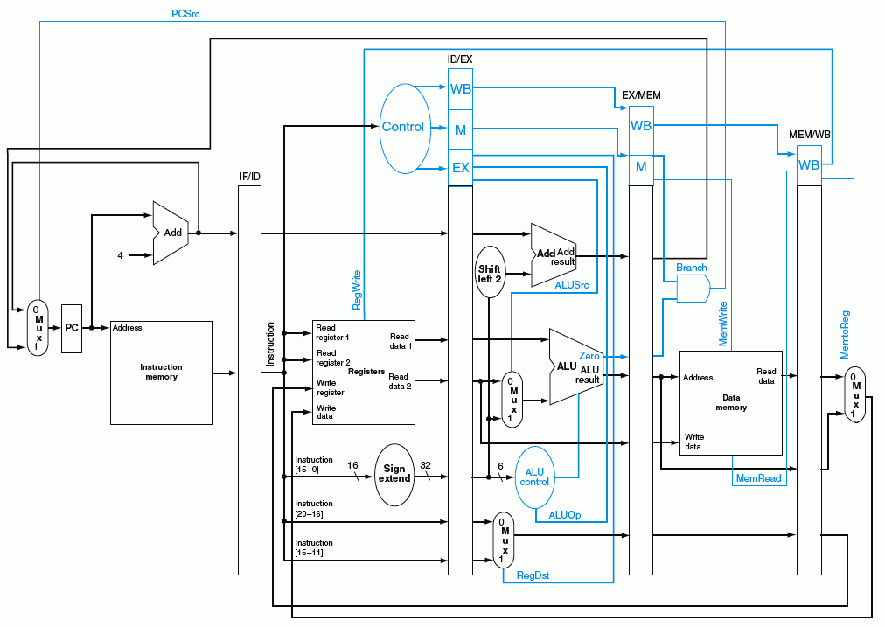
蓝色部分是控制信号

Slide 32
Load指令:流水线中的控制信号
在取数/译码（Reg/Dec）阶段产生本指令每个阶段的所有控制信号
  Exec信号 (ExtOp, ALUSrc, ...) 在1个周期后使用
  Mem信号 (MemWr, Branch) 在2个周期后使用
  Wr信号 (MemtoReg, RegWr) 在3个周期后使用
(这里是否会有问题？)
所以，控制信号也要保存在流水段寄存器中！
Rt和Data在RegWr后到达怎么办？
Reg/Dec
Exec
Mem
Wr
ExtOp
ExtOp
同样，这里也有问题！
ALUSrc
ALUSrc
ALUOp
ALUOp
Rt
Main
Control
RegDst
RegDst
IF/ID Register
ID/Ex Register
Ex/Mem Register
Mem/Wr Register
MemWr
MemWr
MemWr
Data
Branch
Branch
Branch
MemtoReg
MemtoReg
MemtoReg
MemtoReg
RegWr
RegWr
RegWr
RegWr
保存在流水段寄存器中的信息（包括前面阶段传递来或执行的结果及控制信号）一起被传递到下一个流水段！
Notes:
The main control here is identical to the one in the single cycle processor. It generate all the control
signals necessary for a given instruction during that instruction’s Reg/Decode stage.
All these control signals will be saved in the ID/Exec pipeline register at the end of the Reg/Decode cycle.
The control signals for the Exec stage (ALUSrc, ... etc.) come from the output of the ID/Exec register. That is they are delayed ONE cycle from the cycle they are generated.
The rest of the control signals that are not used during the Exec stage is passed down the pipeline and saved in the Exec/Mem register.
The control signals for the Mem stage (MemWr, Branch) come from the output of the Exec/Mem register. That is they are delayed two cycles from the cycle they are generated.
Finally, the control signals for the Wr stage (MemtoReg & RegWr) come from the output of the Exec/Wr register: they are delayed three cycles from the cycle they are generated.
+2 = 45 min. (Y:45)

Slide 33
Wr阶段的开始: 存在一个实际的问题！
Clk
Clk
RegAdr
WrAdr
RegWr
MemWr
RegWr’s Clk-to-Q
MemWr’s Clk-to-Q
RegAdr’s Clk-to-Q
WrAdr’s Clk-to-Q
RegWr
MemWr
Mem/Wr
Ex/Mem
RegAdr
Reg
File
WrAdr
Data
Memory
Data
Data
在流水线中也存在地址 和 写使能之间的“竞争”问题
  Wr段开始时若RegAdr’s(Rd/Rt)Clk-to-Q > RegWr’s Clk-to-Q, 则错写寄存器！
  Mem 阶段开始时若WrAdr’s Clk-to-Q > MemWr’s Clk-to-Q, 则错写存储器！
不能用多周期中的方法！为什么？
哪个同学记得多周期中是如何处理“竞争”问题的？
Notes:
Let’s focus our attention to the beginning of the Wr stage and see what happens there.
Recalled from our pipelined datapath that at the beginning of the Register Write back cycle, the register address, that is Rw, will come from the output of the Mem/Wr pipeline register.
From our pipeline control discussion, we also know that the register write enable signal (RegWr) will also come from the pipeline register Mem/Wr.
Consequently, at the beginning of the Register Wr stage, we can have a problem if the RegAdr’s Clock-to-Q time is longer than the RegWr’s clock to Q time.
Because in that case, RegWr can be asserted BEFORE the register specifier (RegAdr) is settled to its final value and cause us to write to the wrong register.
Similarly, we can have a problem at the beginning of the Memory Access stage if the Clock-to-Q time of the memory Write address is longer than the MemWr’s clock-to-q time.
In either case, we have a race condition between the address lines and the write enable control signal.
Did anybody remember how did we prevent this (address and write enable) race condition in our multiple cycle design?
+2 = 52 min. (Y:32)

Slide 34
流水线中的“竞争”问题
多周期中解决 Addr 和 WrEn之间竞争问题的方法:
  在第 N周期结束时，让Addr信号有效
  在第 N + 1周期让WrEn有效
上述方法在流水线设计中不能用，因为：
  每个周期必须能够写Register
  每个周期必须能够写Memory
保证Addr信号在WriteEnable信号之前到达
Clock
Store
Ifetch
Reg/Dec
Exec
Mem
Wr
Store
Ifetch
Reg/Dec
Exec
Mem
Wr
R-type
Ifetch
Reg/Dec
Exec
Mem
Wr
如何解决?
R-type
Ifetch
Reg/Dec
Exec
Mem
Wr
Notes:
Well in our multiple cycle design, we prevent the race condition between the write address lines and the write enable signal by:
(a) Making sure the address is stable by the end of a given cycle, say Cycle N.
(b) Then we assert the write enable line to write the memory 1 cycle later (Cycle N +1).
In other words, it will take us two cycles (Cycle N and Cycle N + 1) to write anything.
This approach, however, cannot be used in the pipeline design because we must be able to write the register file every cycle when we have consecutive R-type instructions.
Similarly, we must be able to write the data memory every cycle when we encounter consecutive store instructions.
So we need to look for a solution that is different from the multiple cycle implementation.
+2 = 54 min. (Y:34)

Slide 35
寄存器组的同步和存储器的同步
解决方案: 将Write Enable和时钟信号“与”
  须由电路专家确保不会发生“定时错误”（即：能合理设计“Clock”!）
Clk
1. Addr, Data, 和 WrEn 必须在Clk边沿到来后至少稳定一个 set-up时间
2. Clk高电平时间 大于 写入时间
I_Addr
I_WrEn
C_WrEn
Actual write
WrEn
WrEn
C_WrEn
Address
Data
Reg File
or
Memory
I_WrEn
等价于
Clk
Address
I_Addr
Reg File
or
Memory
Data
I_Data
相当于单周期通路中的理想寄存器和存储器
Notes:
The solution we have is to AND the write enable signal to the clock input.
The Write Enable signal to register file or memory is probably the ONLY place where you as a logic designer can gate (AND) the clock with a control signal.
This is the place where you need to take off your logic designer’s hat and put on an electrical engineer’s hat to make sure by ANDING the write enable signal to the clock signal, you are NOT violating any timing consideration.
One obvious thing you should check is that the clock high time must be greater than the write access time because the C_WrEn signal will only be high during the clock high time.
After the circuit designer have taken a good look at this block and make sure no timing constraint is violated, he or she will create a symbol like this and give it to the logic designer.
And he probably will tell the logic designer something like: “Hey, don’t change anything in this block without first asking me.” The logic designer can then use it just like any logic element.
What we created here (the box) is what in the industry is called Synchronized SRAM if this block is the Data Memory. Or Synchronized Register File if this block is the Register File.
The synchronized memory and register file should be no stranger to you guys because I have already shown you how they can be used in the Single Cycle Datapath lecture.
All you have to do is make sure the address, data, and write enable signal are stable at least one set-up time before the clock tick.
The actual write will occur at the cycle following the clock edge that captures the WrEn=1.
+3 = 57 min. (Y:37)

Slide 36
流水线举例：考察流水线DataPath的数据流动情况
Cycle 1
Cycle 2
Cycle 3
Cycle 4
Cycle 5
Cycle 6
Cycle 7
Cycle 8
Clock
0: Load
Ifetch
Reg/Dec
Exec
Mem
Wr
4: R-type
Ifetch
Reg/Dec
Exec
Mem
Wr
8: Store
Ifetch
Reg/Dec
Exec
Mem
Wr
12: Beq (target is 1000)
Ifetch
Reg/Dec
Exec
Mem
Wr
考察以下几个点的情况：
End of
Cycle 4
End of
Cycle 5
End of
Cycle 6
End of
Cycle 7
End of Cycle 4: Load’s Mem, R-type’s Exec, Store’s Reg, Beq’s Ifetch
End of Cycle 5: Load’s Wr, R-type’s Mem, Store’s Exec, Beq’s Reg
End of Cycle 6: R-type’s Wr, Store’s Mem, Beq’s Exec
End of Cycle 7: Store’s Wr, Beq’s Mem
说明：后面仅考察数据流动情况，控制信号随数据同步流动因而不再说明。
Notes:
Well, let’s look at a more complex example so I can show you how different instructions at different stages of execution can be processed by our pipelined datapath simultaneously.
Let’s consider the following instruction sequence: Load, R-type, Store, and then Branch on equal to target address 1000.
In the next four slides, I will show you the state of the datapath at the end of Cycle 4, Cycle 5, Cycle 6 and Cycle 7.
First let’s take a look at the end of Cycle 4 where:
(a) The Load instruction has just finished its Mem stage.
(b) The R-type instruction has just finished its Exec stage.
(c) The Store instruction has just finished its Register Fetch slash Instruction Decode stage.
(d) And finally, the Branch instruction has just finish fetching the instruction.
Remember now, the next four pictures we will be looking at are at the end of a clock cycle. That is right at the clock tick.
+2 = 59 min. (Y:39)

Slide 37
第四周期结束时的状态：
0: Load’s Mem 4: R-type’s Exec 8: Store’s Reg 12: Beq’s Ifetch
12: Beq’s Ifet
8: Store’s Reg
4: R-type’s Exec
0: Load’s Mem
?’s Wr
ALUOp=R-type
RegWr=?
ExtOp=x
Branch=0
Load指令前某指令
Clk
1
0
PC+4
PC+4
PC+4
Imm
Imm
PC = 16
Rs
busA
Zero
Data
Mem
A
Ra
busB
IF/ID: Beq Instruction
Exec
Unit
RA
Do
Rb
Mem/Wr: Load’s Dout
IUnit
ID/Ex: Store’s busA & B
Ex/Mem: R-type’s Result
1
Rt
RFile
WA
Di
Mux
Rt
Rw
Di
I
0
0
Rd
1
如果Mem阶段是Branch且Zero为1，会怎样？
RegDst=1
ALUSrc=0
Clk
MemtoReg=?
MemWr=0
Notes:
So the internal value of the register has just been updated BUT the output of the register, due to the Clock-to-Q delay, has NOT been changed to reflect the new internal value.
The output of the register will still has the value from the cycle that has just ended.
For example, look at Ifetch stage of the pipeline. The output of PC will still have the values of 12, the location of the Branch instruction even though PC has been updated to 16.
Furthermore, the IF/ID register’s internal value have already been updated to the Branch instruction even though its output still contains the Store instruction so that we can read the registers (Ra and Rb) for the store instruction and store their values into the ID/Ex register.
In order to get ready for calculating the store address, we also needs to pass the immediate field to the next stage.
At the end of Cycle 4, the Exec stage of the pipeline have just completed the ALUOp for the R-type instruction so the ALU output is stored into the Exec/Mem register.
Notice that for R-type instruction, the Rd field of the instruction is used to specify the destination register so the RegDst control signal must be set to 1 to pass Rd down the pipe.
The Mem stage of the pipeline have just completed the data memory read access for the load instruction so the data to be loaded can be found in the Mem/Wr register.
In the pipeline diagram, I did not show any instruction prior to the load instruction so we do NOT have any instruction in the Wr stage yet (MemtoReg=X, RegWr=0).
So far so good. Let’s take a look at what happened at the next clock cycle.
+3 = 62 min. (Y:42)

Slide 38
第五周期结束时的状态：
0: Lw’s Wr 4: R’s Mem 8: Store’s Exec 12: Beq’s Reg 16: R’s Ifetch
16: R’s Ifet
12: Beq’s Reg
8: Store’s Exec
4: R-type’s Mem
0: Load’s Wr
ALUOp=Add
RegWr=1
ExtOp=1
Branch=0
Clk
1
0
PC+4
PC+4
PC+4
Imm
Imm
20
PC = 16
Rs
busA
Zero
Data
Mem
A
Ra
busB
Rb
Exec
Unit
RA
Do
IF/ID: Instruction @ 16
ID/Ex: Beq’s busA & B
Ex/Mem: Store’s Address
Mem/Wr: R-type’s Result
IUnit
Rt
1
RFile
WA
Mux
Rw
Di
Di
Rt
0
0
I
Rd
1
同一周期寄存器有读和写，可能吗？
利用时钟上升和下降沿两次触发，能做到前半周期写，后半周期读
RegDst=x
ALUSrc=1
Clk
MemtoReg=1
MemWr=0
寄存器的写口和读口可看成是独立的两个部件！
Notes:
Well we are now at the END of Cycle 5. Looking at Ifetch stage of the pipeline. The output of PC will still have the values of 16even though PC has been updated to 20.
I have assumed the instruction at memory location 16 to be a R-type instruction so the IF/ID register’s internal value will contain this R-type instruction even though its output still contains the Branch instruction that has just completed its Register Fetch stage (ID/Ex).
In order to get ready for calculating the branch target address, we also needs to pass the immediate field to the next stage.
At the end of Cycle 5, the Exec stage of the pipeline has just completed the address calculation for the Store instruction which involves adding the sign extended (ExtOp=1) version of the Immediate field (ALUSrcA) to the Rs register (busA).
This Store address is stored in the Ex/Mem register so it can be used in the next clock cycle.
Notice that for R-type instruction, the Mem stage is a NoOp stage. All we do is to pass the ALU output AS WELL AS the Rd field from the ID/Ex register to the Mem/Wr register.
At the end of Cycle 5, the Wr stage of the pipeline has just completed the Register File write for the load instruction
Therefor, RegWr is set to 1 for the register write and MemtoReg is set to 1 to route the data memory output we saved from last cycle (output of Mem/Wr register) to the register file.
+3 = 65 min. (Y:45)

Slide 39
第六周期结束时的状态：
4: R’s Wr 8: Store’s Mem 12: Beq’s Exec 16: R’s Reg 20: R’s Ifet
20:R-type’s Ifet
16: R-type’s Reg
12: Beq’s Exec
8: Store’s Mem
4: R-type’s Wr
ALUOp=Sub
RegWr=1
ExtOp=1
Branch=0
Clk
1
0
PC+4
PC+4
PC+4
Imm
Imm
PC = 24
Rs
busA
Zero
Data
Mem
A
Ra
busB
Rb
Exec
Unit
RA
Do
IF/ID: Instruction @ 20
ID/Ex:R-type’s busA & B
Ex/Mem: Beq’s Results
Mem/Wr: Nothing for St
IUnit
Rt
1
RFile
WA
Mux
Rw
Di
Di
Rt
0
0
I
Rd
1
Ifetch和Reg两个周期每条指令执行的都一样！
RegDst=x
ALUSrc=0
Clk
MemtoReg=0
MemWr=1
Notes:
Now, let take a look at the end of Cycle 6.
The Branch instruction has just completed its Exec stage so the signal Zero will be asserted if the two registers (busA and busB) we compared (ALUOp=sub) are equal.
This value of Zero (2nd from top) as well as the branch target address (top), that is the sum of PC+4 and the sign extended version (ExtOp=1) of the immediate filed , must be stored in the Ex/Mem register (Beq’s result).
The Mem stage of the pipeline has just completed the operation for the store instruction where the value from bus B is stored (MemWr=1) into the memory address location specified by the ALU output.
The Wr stage of the pipeline has just completed the operation for the R-type instruction.
Therefore MemtoReg is set to zero to route the ALU output we saved in the Mem/Reg register to the register file where RegWrite is set to 1 to complete the write.
+2 = 47 min. (Y:47)

Slide 40
第七周期结束时的状态：
8: Store’s Wr 12: Beq’s Mem 16: R’s Exec 20: R’s Reg 24: R’s Ifet
24:R-type’s Ifet
20: R-type’s Reg
16: R-type’s Exec
12: Beq’s Mem
8: Store’s Wr
ALUOp=R-type
RegWr=0
ExtOp=x
Branch=1
Clk
1
0
PC+4
PC+4
PC+4
Imm
Imm
PC = 1000
Rs
busA
Zero
Data
Mem
A
Ra
busB
Rb
Exec
Unit
RA
Do
IF/ID: Instruction @ 24
ID/Ex:R-type’s busA & B
Ex/Mem: Rtype’s Results
Mem/Wr:Nothing for Beq
IUnit
Rt
1
假定相等，
则Zero=1
转移目标地址送PC!
RFile
WA
Mux
Rw
Di
Di
Rt
0
0
I
Rd
1
这里出现反向数据流!
转移目标地址反向送给PC可能会导致控制冒险！
Clk
RegDst=1
ALUSrc=0
MemtoReg=x
MemWr=0
Notes:
Finally, let’s take a look at the end of Cycle 7 where the Branch instruction has just completed its Mem stage.
I have assumed the registers we compared in the last cycle are indeed equal so ALU output Zero was asserted and captured in the Ex/Mem register.
With Zero asserted and the control signal Branch set to 1, the branch target address we calculated in Cycle 6 and saved in the Ex/Mem register is now written into the PC (1000).
By writing the branch target address into the Program Counter, we have just completed the branch instruction.
+2 = 69 min. (Y:49)

Slide 41
总结前面的流水线执行过程
Cycle 1
Cycle 2
Cycle 3
Cycle 4
Cycle 5
Cycle 6
Cycle 7
Cycle 8
Clock
0: Load
Ifetch
Reg/Dec
Exec
Mem
Wr
4: R-type
Ifetch
Reg/Dec
Exec
Mem
Wr
8: Store
Ifetch
Reg/Dec
Exec
Mem
Wr
12: Beq (target is 1000)
Ifetch
Reg/Dec
Exec
Mem
Wr
16: R-type
Ifetch
Reg/Dec
Exec
Mem
Wr
20: R-type
Ifetch
Reg/Dec
Exec
Mem
Wr
24: R-type
Ifetch
Reg/Dec
Exec
Mem
1000: Target of Br
Ifetch
Reg/Dec
Exec
回忆刚才的过程，回答以下问题：
  Branch指令何时确定是否转移？转移目标地址在第几周期计算出来？
    第六周期得到Zero和转移地址、第七周期控制转移地址送到PC输入端、第八周期开始才能根据转移地址取指令
    如果Branch指令执行结果是需要转移（称为taken），则流水线会怎样？
  Load指令何时能把数据写到寄存器？第几周期开始写数据？
    第五周期写入、第六周期开始才能使用
    如果后面R-Type的操作数是load指令目标寄存器的内容，则流水线怎样？

Slide 42
转移分支指令(Branch)引起的“延迟”现象
Cycle 4
Cycle 5
Cycle 6
Cycle 7
Cycle 8
Cycle 9
Cycle 10
Cycle 11
Clk
12: Beq
(target is 1000)
Ifetch
Reg/Dec
Exec
Mem
Wr
16: R-type
Ifetch
Reg/Dec
Exec
Mem
Wr
20: R-type
Ifetch
Reg/Dec
Exec
Mem
Wr
24: R-type
Ifetch
Reg/Dec
Exec
Mem
Wr
1000: Target of Br
Ifetch
Reg/Dec
Exec
Mem
Wr
虽然Beq指令在第四周期取出，但:
  目标地址在第七周期才被送到PC的输入端
  第八周期才能取出目标地址处的指令执行
  结果：在取目标指令之前，已有三条指令被取出，取错了三条指令！
这种现象称为控制冒险（Control Hazard ）
（注：也称为分支冒险或转移冒险（Branch Hazard） ）
BACK
Notes:
Notice that although the branch instruction is fetched during Cycle 4, its target address is NOT written into the Program Counter until the end of clock Cycle 7.
Consequently, the branch target instruction is not fetched until clock Cycle 8.
In other words, there is a 3-instruction delay between the branch instruction is issued and the branch effect is felt in the program.
This is referred to as Branch Hazard in the text book.
And as we will show in the next lecture, by clever design techniques, we can reduce the delay to ONE instruction.
That is if the branch instruction in Location 12 is issued in Cycle 4, we will only execute one more sequential instruction (Location 16) before the branch target is executed.
+2 = 71 min. (Y:51)

Slide 43
装入指令(Load)引起的“延迟”现象
Cycle 1
Cycle 2
Cycle 3
Cycle 4
Cycle 5
Cycle 6
Cycle 7
Cycle 8
Clock
I0: Load
Ifetch
Reg/Dec
Exec
Mem
Wr
Plus 1
Ifetch
Reg/Dec
Exec
Mem
Wr
Plus 2
Ifetch
Reg/Dec
Exec
Mem
Wr
Plus 3
Ifetch
Reg/Dec
Exec
Mem
Wr
R-Type
Ifetch
Reg/Dec
Exec
Mem
Wr
尽管Load指令在第一周期就被取出，但:
  数据在第五周期结束才被写入寄存器
  在第六周期时，写入的数据才能被用
  结果：在Load指令结果有效前，已经有三条指令被取出
  (如果随后的指令要用到Load的数据的话，就需要延迟三条指令才能用！)
这种现象被称为 数据冒险 (Data Hazard) 或数据相关(Data Dependency )
Notes:
Similarly, although the load instruction is fetched during cycle 1, the data is not written into the register file until the end of Cycle 5.
Consequently, the earliest time we can read this value from the register file is in Cycle 6.
In other words, there is a 3-instruction delay between the load instruction and the instruction that can use the result of the load.
This is referred to as Data Hazard in the text book.
We will show in the next lecture that by clever design techniques, we can reduce this delay to ONE instruction.
That is if the load instruction is issued in Cycle 1, the instruction comes right next to it (Plus 1) cannot use the result of this load but the next-next instruction (Plus 2) can.
+2 = 73 min. (Y:53)

Slide 44
第一讲内容小结
指令的执行可以像洗衣服一样，用流水线方式进行
  均衡时指令吞吐率提高N倍，但不能缩短一条指令的执行时间
  流水段数以最复杂指令所需步骤数为准（有些指令的某些阶段为空操作），每个阶段的宽度以最复杂阶段所需时间为准（尽量调整使各阶段均衡）
以Load指令为准，分为五个阶段
  取指令段(IF)
    取指令、计算PC+4（IUnit：Instruction Memory、Adder）
  译码/读寄存器(ID/RF)段
    指令译码、读Rs和Rt（寄存器读口）
  执行(EXE)段
    计算转移目标地址、ALU运算（Extender、ALU、Adder）
  存储器(MEM)段
    读或写存储单元（Data Memory）
  写寄存器(Wr)段
    ALU结果或从DM读出数据写到寄存器（寄存器写口）
流水线控制器的实现
  IF和ID/RF段不需控制信号控制，只有EXE、MEM和Wr需要
  ID段生成所有控制信号，并随指令的数据同步向后续阶段流动
寄存器和存储器的竞争问题可利用时钟信号来解决
流水线冒险：结构冒险、控制冒险、数据冒险
（下一讲主要介绍解决流水线冒险的数据通路如何设计）

Slide 45
第二讲 流水线冒险的处理
主 要 内 容
流水线冒险的几种类型
数据冒险的现象和对策
  数据冒险的种类
    相关的数据是ALU结果：可以通过转发解决
    相关的数据是DM读出的内容：随后的指令需被阻塞一个时钟
  数据冒险和转发
    转发检测 / 转发控制
  数据冒险和阻塞
    阻塞检测 / 阻塞控制
控制冒险的现象和对策
  静态分支预测技术
  动态分支预测技术
  缩短分支延迟技术
流水线中对异常和中断的处理
访问缺失对流水线的影响

Slide 46
总结：流水线的三种冲突/冒险（Hazard）情况
Hazards：指流水线遇到无法正确执行后续指令或执行了不该执行的指令
  Structural hazards (hardware resource conflicts):
  现象：同一个部件同时被不同指令所使用
    一个部件每条指令只能使用1次，且只能在特定周期使用
    设置多个部件，以避免冲突。如指令存储器IM 和数据存储器DM分开
  Data hazards (data dependencies):
  现象：后面指令用到前面指令结果时，前面指令结果还没产生
    采用转发(Forwarding/Bypassing)技术
    Load-use冒险需要一次阻塞(stall)
    编译程序优化指令顺序
  Control (Branch) hazards (changes in program flow):
  现象：转移或异常改变执行流程，顺序执行指令在目标地址产生前已被取出
    采用静态或动态分支预测
    编译程序优化指令顺序(实行分支延迟)
SKIP

Slide 47
Structural Hazard（结构冒险）现象
Time (clock cycles)
Load
Mem
Reg
ALU
Mem
Reg
Instr 1
Mem
Reg
ALU
Mem
Reg
Instr 2
Mem
Reg
ALU
Mem
Reg
Instr 3
Mem
Reg
ALU
Mem
Reg
Instr 4
Mem
Reg
ALU
Mem
Reg
如果只有一个存储器，则在Load指令取数据同时又取指令的话，则发生冲突！
如果不对寄存器堆的写口和读口独立设置的话，则发生冲突！
结构冒险也称为硬件资源冲突：同一个执行部件被多条指令使用。

Slide 48
Structural Hazard的解决方法
为了避免结构冒险，规定流水线数据通路中功能部件的设置原则为：
每个部件在特定的阶段被用！（如：ALU总在第三阶段被用！）
将Instruction Memory (Im) 和 Data Memory (Dm)分开
将寄存器读口和写口独立开来
Time (clock cycles)
I
n
s
t
r.
O
r
d
e
r
Load
Im
Reg
ALU
Dm
Reg
Instr 1
Im
Reg
ALU
Dm
Reg
BACK
Instr 2
Im
Reg
ALU
Dm
Reg
Instr 3
Im
Reg
ALU
Dm
Reg
Instr 4
Im
Reg
ALU
Dm
Reg

Slide 49
Data Hazard现象
举例说明：以下指令序列中，寄存器r1会发生数据冒险
想一下，哪条指令的r1是老的值？
哪条是新的值？
add r1 ,r2,r3
sub r4, r1 ,r3
读r1时，add指令正在执行加法(EXE)，老值!
and r6, r1 ,r7
读r1时，add指令正在传递加法结果(MEM), 老值!
or r8, r1 ,r9
读r1时，add指令正在写加法结果到r1(WB), 老值!
xor r10, r1 ,r11
读r1时，add指令已经把加法结果写到r1, 新值
画出流水线图能很清楚理解！
补充：三类数据冒险现象
RAW: 写后读（基本流水线中经常发生，如上例）
WAR：读后写（基本流水线中不会发生，多个功能部件时会发生）
WAW：写后写（基本流水线中不会发生，多个功能部件时会发生）
本讲介绍基本流水线，所以仅考虑RAW冒险

Slide 50
Data Hazard on r1
Time (clock cycles)
IF
ID/RF
EX
MEM
WB
add r1,r2,r3
Im
Reg
ALU
Dm
Reg
I
n
s
t
r.
O
r
d
e
r
sub r4,r1,r3
Im
Reg
ALU
Dm
Reg
and r6,r1,r7
Im
Reg
ALU
Dm
Reg
or r8,r1,r9
Im
Reg
ALU
Dm
Reg
xor r10,r1,r11
Im
Reg
ALU
Dm
Reg
最后一条指令的r1才是新的值！
如何解决这个问题？

Slide 51
方案1: 在硬件上采取措施，使相关指令延迟执行
硬件上通过阻塞(stall)方式阻止后续指令执行，延迟到有新值以后！
这种做法称为流水线阻塞，也称为“气泡Bubble”
Time (clock cycles)
IF
ID/RF
EX
MEM
WB
add r1,r2,r3
Im
Reg
ALU
Dm
Reg
I
n
s
t
r.
O
r
d
e
r
stall
Im
bubble
bubble
bubble
bubble
stall
Im
bubble
bubble
bubble
bubble
stall
Im
bubble
bubble
bubble
bubble
sub r4,r1,r3
Im
Reg
Dm
Reg
ALU
and r6,r1,r7
Im
Reg
Dm
ALU
缺点：控制相当复杂，需要改数据通路！
Notes:
The same instruction means the same one as the first instruction add r1, r2, r3 . So the remaining instructions are not affected.

Slide 52
方案 2: 软件上插入无关指令
最差的做法：由编译器插入三条NOP指令，浪费三条指令的空间和时间
Time (clock cycles)
IF
ID/RF
EX
MEM
WB
add r1,r2,r3
Im
Reg
ALU
Dm
Reg
I
n
s
t
r.
O
r
d
e
r
nop
Im
Reg
ALU
Dm
Reg
nop
Im
Reg
ALU
Dm
Reg
nop
Im
Reg
ALU
Dm
Reg
sub r4,r1,r3
Im
Reg
Dm
Reg
ALU
and r6,r1,r7
Im
Reg
ALU
Dm

Slide 53
方案3: 利用DataPath中的中间数据
仔细观察后发现：流水段寄存器中已有需要的值r1！
在哪个流水段R中？
Time (clock cycles)
IF
ID/RF
EX
MEM
WB
add r1,r2,r3
Im
Reg
ALU
Dm
Reg
I
n
s
t
r.
O
r
d
e
r
sub r4,r1,r3
Im
Reg
ALU
Dm
Reg
and r6,r1,r7
Im
Reg
ALU
Dm
Reg
or r8,r1,r9
Im
Reg
ALU
Dm
Reg
xor r10,r1,r11
Im
Reg
ALU
Dm
Reg
1. 把数据从流水段寄存器中直接取到ALU的输入端
2. 寄存器写/读口分别在前/后半周期，使写入被直接读出
称为转发（Forwading）或旁路（Bypassing）
BACK

Slide 54
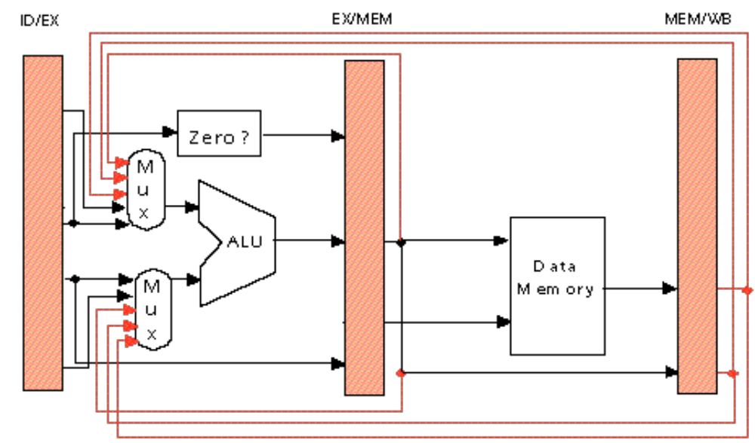
硬件上的改动以支持“转发”技术
加MUX，使流水段寄存器值返送ALU输入端
假定流水段寄存器能读出新写入的值 (否则，需要更多的转发数据)
Ex
Mem
add r3, r2, r1
Sub r5, r3, r4
lw r3, 100(r1)
Or r6, r2, r1
Sub r5, r3, r4
add r3, r2, r1
Or r6, r2, r1
Sub r5, r3, r4
如果指令序列为：
lw r3, 100(r1)
Or r6, r3, r1
Sub r5, r3, r4
能用“转发”技术解决第1、2两条指令间的数据冒险吗？
请看后面的幻灯片！
Notes:
Why do we need the orange-color forwarding? See the following examples. The result of present instruction(1st one) is needed by next next instruction(3rd one).
Add R3, R2, R1 Add R3, R2, R1
Add R5, R4, R3 Lw R5, 100(R3)
Add R6, R5, R3 Add R6, R5, R3
Add R7, R6, R3
What is the meaning of the 2nd bullet? It means that register read of R3 gets the new result of register write R3 in the 1st instruction. That is, the 4th instruction can get the result of the 1st instruction without forwarding.

Slide 55
复习: Load指令引起的延迟现象
Cycle 1
Cycle 2
Cycle 3
Cycle 4
Cycle 5
Cycle 6
Cycle 7
Cycle 8
Clock
I0: Load
Ifetch
Reg/Dec
Exec
Mem
Wr
Plus 1
Ifetch
Reg/Dec
Exec
Mem
Wr
Plus 2
Ifetch
Reg/Dec
Exec
Mem
Wr
Plus 3
Ifetch
Reg/Dec
Exec
Mem
Wr
若不采用转发，则在何时才能用使用Load指令的结果？
Plus 4
Ifetch
Reg/Dec
Exec
Mem
Wr
Load指令最早在哪个流水线寄存器中开始有后续指令需要的值？
实际上，在第四周期结束时，数据在流水段寄存器中已经有值。
采用数据转发技术可以使load指令后面第二条指令得到所需的值
但不能解决load指令和随后的第一条指令间的数据冒险，要延迟执行一条指令！
这种load指令和随后指令间的数据冒险，称为“装入- 使用数据冒险(load- use Data Hazard)”
Notes:
Similarly, although the load instruction is fetched during cycle 1, the data is not written into the register file until the end of Cycle 5.
Consequently, the earliest time we can read this value from the register file is in Cycle 6.
In other words, there is a 3-instruction delay between the load instruction and the instruction that can use the result of the load.
This is referred to as Data Hazard in the text book.
We will show in the next lecture that by clever design techniques, we can reduce this delay to ONE instruction.
That is if the load instruction is issued in Cycle 1, the instruction comes right next to it (Plus 1) cannot use the result of this load but the next-next instruction (Plus 2) can.
+2 = 73 min. (Y:53)

Slide 56
“Forwarding”技术使Load-use冒险只需延迟一个周期
Time (clock cycles)
IF
ID/RF
EX
MEM
WB
lw r1, 0(r2)
Im
Reg
ALU
Dm
Reg
I
n
s
t
r.
O
r
d
e
r
sub r7,r1,r3
Im
Reg
ALU
Dm
Reg
and r6,r1,r7
Im
Reg
ALU
Dm
Reg
or r8,r1,r9
Im
Reg
ALU
Dm
Reg
采用“转发”后仅第二条指令 SUB r7,r1,r3 不能按时执行！需要阻塞一个周期。
发生“装入- 使用数据冒险”时，需要对load后的指令阻塞一个时钟周期！

Slide 57
方案1: 硬件阻止指令执行来解决load-use
用硬件阻塞一个周期（指令被重复执行一次）
Time (clock cycles)
IF
ID/RF
EX
MEM
WB
lw r1, 0(r2)
Im
Reg
ALU
Dm
Reg
I
n
s
t
r.
O
r
d
e
r
stall
Im
bubble
bubble
bubble
bubble
sub r4,r1,r3
Im
Reg
ALU
Dm
Reg
and r6,r1,r7
Im
Reg
ALU
Dm
Reg
or r8,r1,r9
Im
Reg
ALU
Dm
Reg

Slide 58
方案2: 软件上插入NOP指令来解决load-use
用软件插入一条NOP指令！（有些处理器不支持硬件阻塞处理）
例如：MIPS 1 处理器没有硬件阻塞处理，而由编译器（或汇编程序员） 来处理。
Time (clock cycles)
IF
ID/RF
EX
MEM
WB
lw r1, 0(r2)
Im
Reg
ALU
Dm
Reg
I
n
s
t
r.
O
r
d
e
r
nop
Im
Reg
ALU
Dm
Reg
sub r4,r1,r3
Im
Reg
ALU
Dm
Reg
and r6,r1,r7
Im
Reg
ALU
Dm
Reg
or r8,r1,r9
Im
Reg
ALU
Dm
Reg
Notes:
MIPS I has not the hardware solution and therefore leave the interlock checking work to the user.

Slide 59
方案3：编译器进行指令顺序调整来解决load-use
以下源程序可生成两种不同的代码，优化的代码可避免Load阻塞
a = b + c;
d = e – f;
假定 a, b, c, d ,e, f 在内存
Slow code:
lw $2, b
lw $3, c
add $1, $2, $3
sw a, $1
lw $5, e
lw $6, f
sub $4, $5, $6
sw d, $4
Fast code:
lw $2, b
lw $3, c
lw $5, e
add $1, $2, $3
lw $6, f
sw a, $1
sub $4, $5, $6
sw d, $4
调整后
编译器的优化很重要！

Slide 60
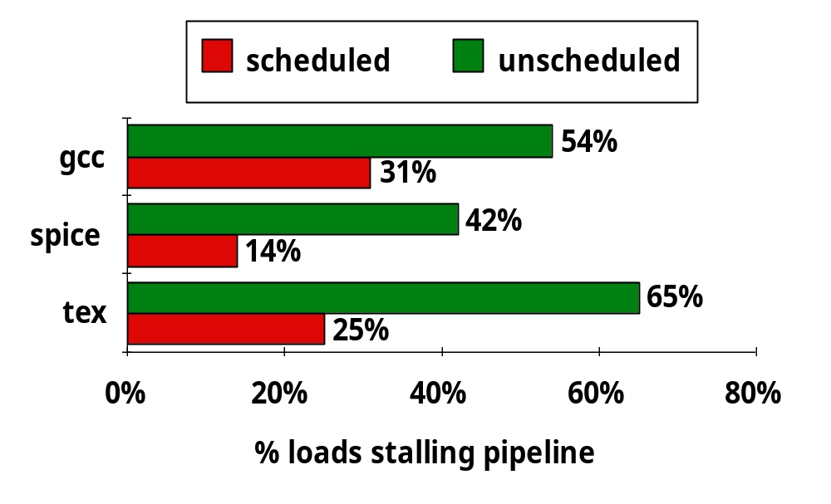
编译器优化以避免阻塞的情况调查:
由此可见，优化调度后load阻塞现象大约降低了1/2~1/3

Slide 61
数据冒险的解决方法
方法1：硬件阻塞（stall）
方法2：软件插入“NOP”指令
方法3：编译优化：调整指令顺序，能解决所有数据冒险吗？
方法4：合理实现寄存器堆的读/写操作，能解决所有数据冒险吗？
  前半时钟周期写，后半时钟周期读，若同一个时钟内前面指令写入的数据正好是后面指令所读数据，则不会发生数据冒险
方法5：转发（Forwarding或Bypassing 旁路）技术，能解决所有数据冒险吗？
    若相关数据是ALU结果，则如何？
    可通过转发解决
    若相关数据是上条指令DM读出内容，则如何？
    不能通过转发解决，随后指令需被阻塞一个时钟 或 加NOP指令
称为Load-use数据冒险！
实现“转发”和“阻塞” 要修改数据通路：
（1）检测何时需要“转发” ，并控制实现“转发”
（2）检测何时需要“阻塞”，并控制实现“阻塞”
BACK

Slide 62
RAW（写后读）数据冒险的“转发”条件
Ex
Mem
C3
C1
ori r3, r2, 100
sub r5, r3, r4
lw r3, 100(r1)
or r6, r2, r1
sub r5, r3, r4
C2
add r3, r2, r1
or r6, r2, r1
sub r5, r3, r4
后面指令需用ALU输出结果
C1: 目寄是后一条指令的源寄
C2: 目寄是后第二条指令的源寄
(例如：R-Type后跟R- / lw / sw / beq等)
后面指令需用从DM读出的结果
C3: 目寄是后第二指令的源寄
(例如：load指令后跟R-Type / beq等)
用流水段寄存器来表示转发条件（C3以后考虑）
C1(a): EX/MEM. RegisterRd=ID/EX. RegisterRs
C1(b): EX/MEM. RegisterRd=ID/EX. RegisterRt
C2(a): MEM/WB. RegisterRd=ID/EX. RegisterRs
C2(b): MEM/WB. RegisterRd=ID/EX. RegisterRt
这里的RegisterRd是指目的寄存器
实际上是R-type的Rd 或 I-Type的rt
Notes:
Why do we need the orange-color forwarding? See the following examples. The result of present instruction(1st one) is needed by next next instruction(3rd one).
Add R3, R2, R1 Add R3, R2, R1
Add R5, R4, R3 Lw R5, 100(R3)
Add R6, R5, R3 Add R6, R5, R3
Add R7, R6, R3
What is the meaning of the 2nd bullet? It means that register read of R3 gets the new result of register write R3 in the 1st instruction. That is, the 4th instruction can get the result of the 1st instruction without forwarding.

Slide 63
指令的回写（Write Back）阶段
Clk
Ifetch
Reg/Dec
Exec
Mem
Wr
RegWr=1
ExtOp
ALUOp
Branch
1
0
PC+4
PC+4
PC
PC+4
IF/ID:
Imm
Imm
Rs
busA
Zero
Data
Mem
A
Ra
busB
IUnit
Rb
Exec
Unit
RA
Do
ID/Ex Register
Ex/Mem Register
Mem/Wr Register
Rt
1
RFile
WA
Mux
Rw
Di
Di
Rt
0
0
I
Rd
1
Rd还是Rt取决于是R-型指令，还是I-型指令！
RegDst
ALUSrc
MemWr
MemtoReg=1/0
beq r3, r2, 100
sub r5, r3, r2
因为beq指令没有写结果，不能进行转发！
若是beq指令会怎样？
Notes:
The Rt filed of the load instruction will be used in the Register Write back stage of the pipeline (Wr) to specified the register (Rw) where the load data is written.
Since we are writing the load’s data into the register file, the control signal MemtoReg and RegWr must be set to 1.
So this finishes the grand tour of how a load instruction flows through the datapath.
But how about control signals?
+1 = 41 min. (Y:21)

Slide 64
转发条件的进一步完善
beq r3, r2, 100
sub r5, r3, r2
以下两种情况下，根据前面的转发条件转发会发生错误
  指令的结果不写入目的寄存器Rd时
    例如，Beq指令只对rs和rt相减，不写结果到目的寄存器
    即：EX / MEM 或 MEM / WB 流水段寄存器的RegWrite信号为0
  Rd等于$0时
    例如，指令 sll $0, $1, 2 的转发结果为(R[$1]<<2) ，但实际上应该是0
因此，修改转发条件为：
  C1(a): EX/MEM.RegWrite
  and EX/MEM. RegisterRd ≠ 0
  and EX/MEM. RegisterRd=ID/EX. RegisterRs
  C1(b): EX/MEM.RegWrite
  and EX/MEM. RegisterRd ≠ 0
  and EX/MEM. RegisterRd=ID/EX. RegisterRt
  C2(a): MEM/WB.RegWrite
  and MEM/WB. RegisterRd ≠ 0
  and MEM/WB. RegisterRd=ID/EX. RegisterRs
  C2(b): MEM/WB.RegWrite
  and MEM/WB. RegisterRd ≠ 0
  and MEM/WB. RegisterRd=ID/EX. RegisterRt

Slide 65
转发路径和转发条件
加MUX，使流水段寄存器值返送ALU输入端
Ex
Mem
C1反映本条指令和随后指令间的相关关系
C2反映本条指令和随后第二条指令间的相关关系
C1(a)
C3
C2(a)
C2(b)
C1(b)
C1(a)和C1(b)可以合并为一个条件C1 ，并把转发线合一起后同时送A口和B口
即：C1=C1(a) or C1(b)，同样：C2=C2(a) or C2(b)，转发线合起来
实际上红线和兰线可以合并，而且在原数据通路中是合并在一起的。记得吗？
由一个二路选择器（控制端为MemtoReg）合并输出到寄存器堆！
所以不需另外有一个检测条件C3!
C1和C2分别反映哪两条指令的关系呢？
Notes:
Why do we need the orange-color forwarding? See the following examples. The result of present instruction(1st one) is needed by next next instruction(3rd one).
Add R3, R2, R1 Add R3, R2, R1
Add R5, R4, R3 Lw R5, 100(R3)
Add R6, R5, R3 Add R6, R5, R3
Add R7, R6, R3
What is the meaning of the 2nd bullet? It means that register read of R3 gets the new result of register write R3 in the 1st instruction. That is, the 4th instruction can get the result of the 1st instruction without forwarding.

Slide 66
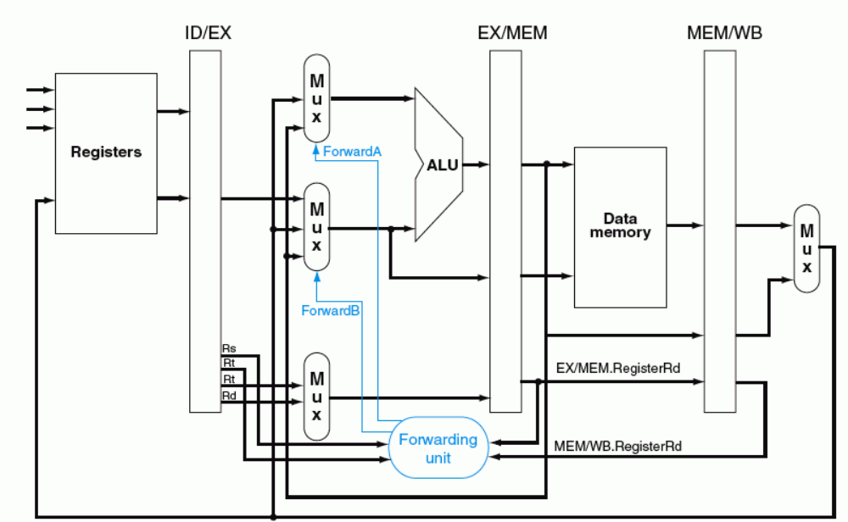
转发路径和转发条件
ForwardA (ForwardB) =
01 当c2=1时
10 当c1=1时
“转发检测”部件中缺何条件？
C1
C2
  C1: EX/MEM.RegWrite and EX/MEM. RegisterRd ≠ 0
  and (EX/MEM. RegisterRd=ID/EX. RegisterRs or EX/MEM. RegisterRd=ID/EX. RegisterRt
  C2: MEM/WB.RegWrite and MEM/WB. RegisterRd ≠ 0
  and (MEM/WB. RegisterRd=ID/EX. RegisterRs or MEM/WB. RegisterRd=ID/EX. RegisterRt

Slide 67
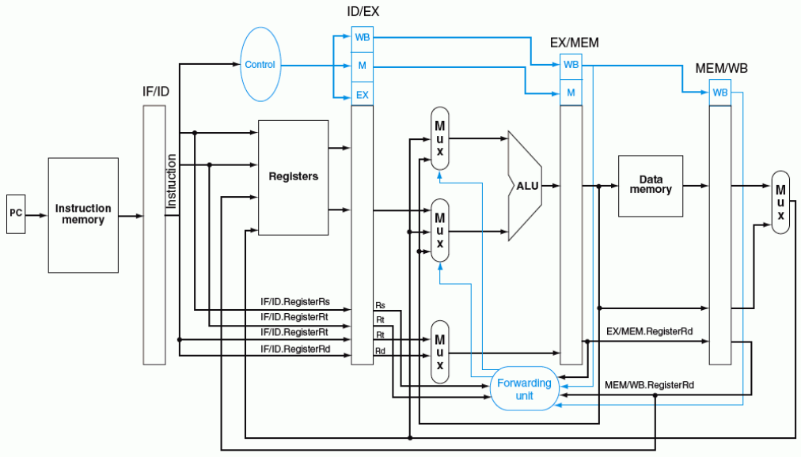
带转发的流水线数据通路
ForwardA (ForwardB) =
01 当c2=1时
10 当c1=1时
ForwardA
ForwardB
C1: EX/MEM.RegWrite and EX/MEM. RegisterRd ≠ 0
and (EX/MEM. RegisterRd=ID/EX. RegisterRs or EX/MEM. RegisterRd=ID/EX. RegisterRt
C2: MEM/WB.RegWrite and MEM/WB. RegisterRd ≠ 0
and (MEM/WB. RegisterRd=ID/EX. RegisterRs or MEM/WB. RegisterRd=ID/EX. RegisterRt

Slide 68
更加复杂的数据冒险问题
考察以下指令序列，采用前述转发条件会发生什么情况？
  add $1, $1, $2
  add $1, $1, $3
  add $1, $1, $4
  ……
  可能会使转发到第3条指令的操作数是第1条指令结果，而不是第2条指令的结果！
怎样改写“转发”检测条件：改C1还是改C2?
需要改写“转发”条件C2为：
ForwardA (ForwardB) =
01 当c2=1时
10 当c1=1时
本条指令
对于左边的指令序列，C1和C2的值各是什么？
C1=C2=1, 使得Forward信号取值不确定！
应该让C1=1,C2=0!
MEM/WB.RegWrite
and MEM/WB.RegisterRd ≠ 0
and (EX/MEM.RegisterRd ≠ ID/EX.RegisterRs or EX/MEM.RegisterRd ≠ ID/EX.RegisterRt)
and (MEM/WB.RegisterRd=ID/EX.RegisterRs or MEM/WB.RegisterRd=ID/EX.RegisterRt)
上述公式相当于加了一个条件限制：
如果本条指令源操作数和上条指令的目的寄存器一样，则不转发上上条指令的结果，
而转发上条指令的结果（即：此时的C1=1而C2=0）
至此，解决了RAW数据冒险的“转发”处理
BACK

Slide 69
Load-use Data Hazard（硬件阻塞方式）
Time (clock cycles)
IF
ID/RF
EX
MEM
WB
lw r1, 0(r2)
Reg
ALU
Reg
I
n
s
t
r.
O
r
d
e
r
Im
Dm
sub r4,r1,r3
检测点
Im
Reg
bubble
bubble
bubble
sub r4,r1,r3
阻塞点
Im
Reg
Dm
Reg
ALU
and r6,r1,r7
Im
Reg
ALU
Dm
Reg
or r8,r1,r9
Im
Reg
ALU
Dm
Reg
需解决以下问题：
(1) 判断什么条件下需要阻塞
  ID/EX.MemRead
  and (ID/EX.RegisterRt=IF/ID.RegisterRs
  or ID/EX.RegisterRt=IF/ID.RegisterRt)
前面指令为Load 并且
前面指令的目的寄存器等于当前刚取出指令的源寄存器
(2) 如何修改数据通路来实现阻塞

Slide 70
Load-use Data Hazard（硬件阻塞方式）
阻塞前的情况：
Time (clock cycles)
I
n
s
t
r.
O
r
d
e
r
IF
ID
EX
MEM
WB
lw r1, 0(r2)
Im
Reg
ALU
Dm
Reg
sub r4,r1,r3
检测点
Im
Reg
ALU
Dm
Reg
and r6,r1,r7
阻塞点
Im
Reg
Dm
Reg
ALU
or r8,r1,r9
Im
Reg
ALU
Dm
Reg
检测“阻塞”过程中：
1) sub指令在IF/ID段寄存器中，并正被译码/取数，控制信号和Rs/Rt的值将被写到ID/EX段寄存器
2) and指令地址在PC中，正被取出，取出的指令将被写到IF/ID段寄存器中
在阻塞点，必须将上述两条指令的执行结果清除，并延迟一个周期执行这两条指令
延迟一个周期执行后面的指令，相当于把阻塞点前面一个周期的状态再保持一个周期
lw指令还是继续正常执行下去
想想看，如何做到继续保持状态？

Slide 71
Load-use Data Hazard（硬件阻塞方式）
Time (clock cycles)
阻塞后的情况：
IF
ID/RF
EX
MEM
WB
I
n
s
t
r.
O
r
d
e
r
lw r1, 0(r2)
Reg
Reg
Im
ALU
Dm
sub r4,r1,r3
检测点
Im
Reg
bubble
bubble
bubble
sub r4,r1,r3
阻塞点
Im
Reg
Dm
Reg
ALU
and r6,r1,r7
Im
Reg
ALU
Dm
Reg
or r8,r1,r9
Im
Reg
ALU
Dm
Reg
在阻塞点，必须将上述两条指令的执行结果清除，并延迟一个周期执行这两条指令
① 将ID/EX段寄存器中所有控制信号清0
② IF/ID寄存器中的信息不变，sub指令重新译码执行
③ PC中的值不变，and指令重新被取出执行

Slide 72
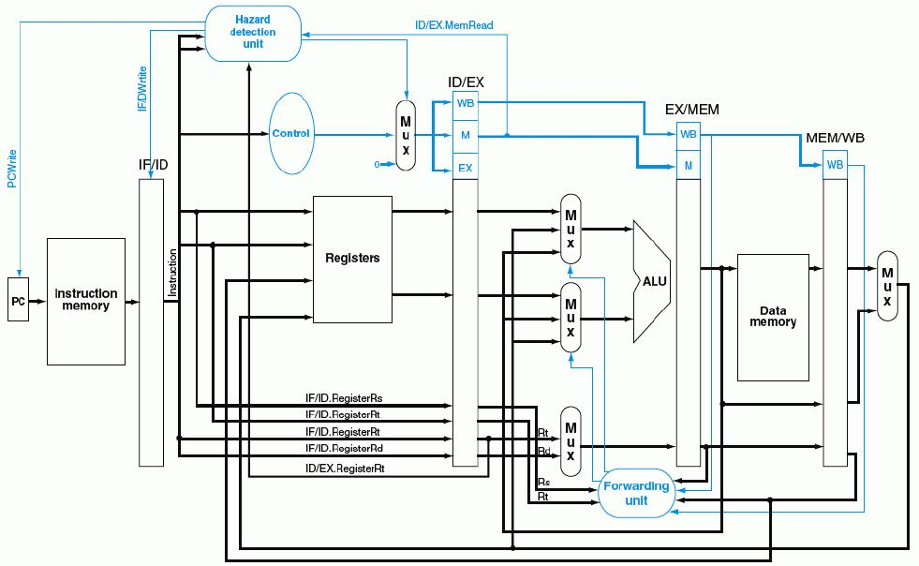
带“转发”和“阻塞”检测的流水线数据通路
  ID/EX.MemRead and (ID/EX.RegisterRt=IF/ID.RegisterRs or ID/EX.RegisterRt=IF/ID.RegisterRt)
使控制信号清0，阻塞随后指令！
①
“写使能”信号为0，使PC和IF/ID不变
②
0
③
至此，数据冒险的处理全部完成！
BACK

Slide 73
Control Hazard的解决方法
方法1：硬件上阻塞（stall）分支指令后三条指令的执行
  使后面三条指令清0或 其操作信号清0，以插入三条NOP指令
方法2：软件上插入三条“NOP”指令
（以上两种方法的效率太低，需结合分支预测进行）
方法3：分支预测（Predict）
  简单（静态）预测：
    总是预测条件不满足(not taken)，即：继续执行分支指令的后续指令
    可加启发式规则：在特定情况下总是预测满足(taken)，其他情况总是预测不满足。如：循环顶（底）部分支总是预测为不满足（满足）。能达65%-85%的预测准确率
  动态预测：
    根据程序执行的历史情况，进行动态预测调整，能达90%的预测准确率
注：采用分支预测方式时，流水线控制必须确保错误预测指令的执行结果不能生
效，而且要能从正确的分支地址处重新启动流水线工作
方法4：延迟分支（Delayed branch）（通过编译程序优化指令顺序！）
  把分支指令前面与分支指令无关的指令调到分支指令后面执行，也称延迟转移
另一种控制冒险：异常或中断控制冒险的处理

Slide 74
简单（静态）分支预测方法
基本做法
  总预测条件不满足(not taken)，即：继续执行分支指令的后续指令
    可加启发式规则：
    在特定情况下总是预测满足(taken)，其他情况总是预测不满足
  预测失败时，需把流水线中三条错误预测指令丢弃掉
    将三条丢弃指令的控制信号值设置为0，使其后续过程中执行nop操作
    （注：涉及到当时在IF、ID和EX三个阶段的指令）
性能
  如果转移概率是50%，则预测正确率仅有50%
预测错误的代价
  预测错误的代价与何时能确定是否转移有关。越早确定代价越少
  可以把“是否转移”的确定工作提前，而不要等到MEM阶段才确定
那最早可以提前到哪个阶段呢？
SKIP

Slide 75
复习: Control Hazard现象
Cycle 4
Cycle 5
Cycle 6
Cycle 7
Cycle 8
Cycle 9
Cycle 10
Cycle 11
Clk
12: Beq
(target is 1000)
Ifetch
Reg/Dec
Exec
Mem
Wr
16: R-type
Ifetch
Reg/Dec
Exec
Mem
Wr
20: R-type
Ifetch
Reg/Dec
Exec
Mem
Wr
24: R-type
Ifetch
Reg/Dec
Exec
Mem
Wr
1000: Target of Br
Ifetch
Reg/Dec
Exec
Mem
Wr
虽然Beq指令在第四周期取出，但:
  “是否转移”在Mem阶段确定，目标地址在第七周期才被送到PC输入端
  第八周期才取出目标地址处的指令执行
  结果：在取目标指令之前，已有三条指令被取出，取错了三条指令！
发生转移时，要在流水线中清除Beq后面的三条指令，分别在EXE 、ID、 IF段中
延迟损失时间片C：发生转移时，给流水线带来的延迟损失
BACK
这里 C=3
Notes:
Notice that although the branch instruction is fetched during Cycle 4, its target address is NOT written into the Program Counter until the end of clock Cycle 7.
Consequently, the branch target instruction is not fetched until clock Cycle 8.
In other words, there is a 3-instruction delay between the branch instruction is issued and the branch effect is felt in the program.
This is referred to as Branch Hazard in the text book.
And as we will show in the next lecture, by clever design techniques, we can reduce the delay to ONE instruction.
That is if the branch instruction in Location 12 is issued in Cycle 4, we will only execute one more sequential instruction (Location 16) before the branch target is executed.
+2 = 71 min. (Y:51)

Slide 76
简单（静态）分支预测方法
缩短分支延迟，减少错误预测代价
  可以通过调整“转移地址计算”和“分支条件判断”操作到ID阶段来缩短延迟
    将转移地址生成从MEM阶段移到ID阶段，可以吗？为什么？
    （是可能的：IF/ID流水段寄存器中已经有PC的值和立即数）
    将“判0”操作从EX阶段移到ID阶段，可以吗？为什么？
    （用逻辑运算(如，先按位异或，再结果各位相或)来直接比较Rs和Rt的值）
    （简单判断用逻辑运算，复杂判断可以用专门指令生成条件码）
    （许多条件判断都很简单）
预测错误的检测和处理（称为“冲刷、冲洗” -- Flush）
  当Branch=1并且Zero=1时，发生转移（taken）
  增加控制信号：IF.Flush=Branch and Zero，取值为1时，说明预测失败
  预测失败(条件满足)时，完成以下两件事（延迟损失时间片C=1时）：
    将转移目标地址->PC
    清除IF段中取出的指令，即：将IF/ID中的指令字清0，转变为nop指令
原来要清除三条指令，调整后只需要清除一条指令，因而只延迟一个时钟周期，每次预测错误减少了两个周期的代价！

Slide 77
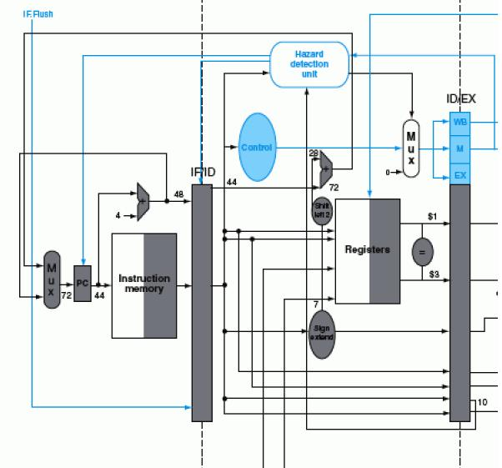
带静态分支预测处理的数据通路
sub $3, $5, $1 add $1, $5, $2
beq $1, $3, 7
IF.Flush=Branch and Zero
40#指令 beq $1,$3, 7的ID阶段
转移目标地址
(72)->PC
控制转移
目标地址->PC
将IF/ID中指令字清0，变为nop指令
若$1或$3和前面指令数据相关，会怎么样？
  上上条指令的EXE段结果可转发回来进行判断
  上条指令的EXE段结果来不及转发回来，引起1次阻塞!
需重新改“转发”条件和转发线路！
作业中有相应的练习
BACK

Slide 78
动态分支预测方法
简单的静态分支预测方法的预测成功率不高，应考虑动态预测
动态预测基本思想：
  利用最近转移发生的情况，来预测下一次可能发生的转移
  预测后，在实际发生时验证并调整预测
  转移发生的历史情况记录在BHT中（有多个不同的名称）
    分支历史记录表BHT（Branch History Table）
    分支预测缓冲BPB（Branch Prediction Buffer）
    分支目标缓冲BTB（Branch Target Buffer）
  每个表项由分支指令地址低位作索引，故在IF阶段就可以取到预测位
    低位地址相同的分支指令共享一个表项，所以，可能取的是其他分支指令的预测位。会不会有问题？
    由于仅用于预测，所以不影响执行结果
现在几乎所有的处理器都采用动态预测（dynamic predictor）

Slide 79
分支历史记录表BHT（或BTB、BPB）
分支指令地址
分支历史记录表BHT
=？
分支指令地址
预测位
转移目标地址
①
查找
转移取
顺序取
查找时发现都不相等，则“未命中”
未命中说明什么？
指令预取器
④ 修正
②
预测
说明以前没有执行过该分支指令
加入新项
③
选择
控制逻辑
命中与否
指令执行
实际执行情况
  命中时：
  根据预测位，选择“转移取”还是“顺序取”
  未命中时：
  加入新项，并填入指令地址和转移目标地址、初始化预测位

Slide 80
动态预测基本方法
采用一位预测位：总是按上次实际发生的情况来预测下次
  1表示最近一次发生过转移（taken），0表示未发生（not taken）
  预测时，若为1，则预测下次taken，若为0，则预测下次not taken
  实际执行时，若预测错，则该位取反，否则，该位不变
  可用一个简单的预测状态图表示
  缺点：当连续两次的分支情况发生改变时，预测错误
    例如，循环迭代分支时，第一次和最后一次会发生预测错误，因为循环的第一次和最后一次都会改变分支情况，而在循环中间的各次总是会发生分支，按上次的实际情况预测时，都不会错。
采用二位预测位
  用2位组合四种情况来表示预测和实际转移情况
  按照预测状态图进行预测和调整
  在连续两次分支发生不同时，只会有一次预测错误
采用比较多的是二位预测位，也有采用二位以上预测位。如：Pentium 4 的BTB2采用4位预测位
BACK

Slide 81
一位预测状态图
发生
正确
不发生
正确
Loop: g = g +A[i];
i = i+ j;
if (i != h) go to Loop:
Assuming variables g, h, i, j ~ $1, $2, $3, $4 and base address
of array is in $5
不发生
错误
预测发生
预测不发生
1
0
发生
错误
指令预取时，按照预测读取相应分支的指令
  预测发生时，选择“转移取”
  预测不发生时，选择“顺序取”
指令执行时，按实际执行结果修改预测位
  对照状态转换图来进行修改
  例如：对于一个循环分支
  若初始状态为0(再次循环时为0)，则第一次和最后一次都错
  若初始状态为1，则只有最后一次会错
Loop: add $7, $3, $3 ; i*2
add $7, $7, $7 ; i*4
add $7, $7, $5
lw $6, 0($7) ; $6=A[i]
add $1, $1, $6 ; g= g+A[i]
add $3, $3, $4
bne $3, $2, Loop
… …
即：只要本次和上次的发生情况不同，就会出现一次预测错误。

Slide 82
举例：双重循环的一位动态预测
… …
Loop-i: beq $t1,$a0, exit-i # 若( i=N)则跳出外循环
add $t2, $zero, $zero #j=0
Loop-j: beq $t2, $a0, exit-j # 若(j=N)则跳出内循环
addi $t2, $t2, 1 # j=j+1
addi $t0, $t0, 1 #sum=sum+1
j Loop-j
exit-j: addi $t1, $t1, 1 # i=i +1
j Loop-i
exit-i: … …
into sum (int N)
{
int i, j, sum=0;
for (i=0; i < N; i++)
for (j=0; j <N; j++)
sum=sum+1;
return sum;
}
外循环中的分支指令共执行N+1次，
内循环中的分支指令共执行N×(N+1)次。
N=10, 分别90.9%和82.7%
N=100, 分别99%和98%
预测位初始为0，外循环只有最后一次预测错误；跳出内循环时预测 位变为1，再进入内循环时，第一次总是预测错误，并且任何一次循环的最后一次总是预测错误，因此，总共有1+2×(N–1)次预测错误。
N越大准确率越高！
BACK

Slide 83
两位预测状态图
发生
正确
不发生
错误
Loop: add $7, $3, $3 ; i*2
add $7, $7, $7 ; i*4
add $7, $7, $5
lw $6, 0($7) ; $6=A[i]
add $1, $1, $6 ; g= g+A[i]
add $3, $3, $4
bne $3, $2, Loop
… …
预测发生
预测发生
00
01
发生
正确
发生
不发生
错误
错误
不发生
正确
预测不发生
预测不发生
10
发生
11
错误
不发生
正确
预测发生时，选择“转移取”
预测不发生时，选择“顺序取”
基本思想：只有两次预测错误才改变预测方向
  00状态时预测发生（强转移），实际不发生时，转到状态01（弱转移），下次仍预测为发生，如果再次预测错误（实际不发生），才使下次预测调整为不发生11
好处：连续两次发生不同的分支情况时，可能会预测正确
  例如，对于循环分支的预测
    第一次：初始态为00（再次循环时状态为01），预测发生，实际也发生，正确
    中间：状态为“00”，预测发生，实际也发生，正确
    最后一次：状态为“00”，预测发生，但实际不发生，错

Slide 84
举例：双重循环的两位动态预测
… …
Loop-i: beq $t1,$a0, exit-i # 若( i=N)则跳出外循环
add $t2, $zero, $zero #j=0
Loop-j: beq $t2, $a0, exit-j # 若(j=N)则跳出内循环
addi $t2, $t2, 1 # j=j+1
addi $t0, $t0, 1 #sum=sum+1
j Loop-j
exit-j: addi $t1, $t1, 1 # i=i +1
j Loop-i
exit-i: … …
into sum (int N)
{
int i, j, sum=0;
for (i=0; i < N; i++)
for (j=0; j <N; j++)
sum=sum+1;
return sum;
}
外循环中的分支指令共执行N+1次，
内循环中的分支指令共执行N×(N+1)次。
N=10, 分别90.9%和90.9%
N=100, 分别99%和99%
预测位初始为00，外循环只有最后一次预测错误；跳出内循环时预测 位变为01，再进入内循环时，第一次预测正确，只有最后一次预测错误，因此，总共有N次预测错误。
N越大准确率越高！
BACK

Slide 85
分支延迟时间片的调度
属于静态调度技术，由编译程序重排指令顺序来实现
基本思想：
  把分支指令前面的与分支指令无关的指令调到分支指令后面执行，以填充延迟时间片（也称分支延迟槽Branch Delay slot），不够时用nop操作填充
举例：如何对以下程序段进行分支延迟调度？
（假定时间片为2）
若分支条件判断和目标地址计算提前到ID阶段，则分支延迟时间片减少为1
lw $1, 0($2)
lw $3, 0($2)
add $6, $4, $2
beq $3, $5, 2
add $3, $3,$2
sw $1, 0($2)
……
lw $3, 0($2)
add $6, $4, $2
beq $3, $5, 2
lw $1, 0($2)
nop
add $3, $3,$2
sw $1, 0($2)
lw $3, 0($2)
add $6, $4, $2
beq $3, $5, 2
lw $1, 0($2)
add $3, $3,$2
sw $1, 0($2)
……
调度后
调度后可能带来其他问题：产生新的load-use数据冒险
调度后，降低了分支延迟损失
BACK

Slide 86
另一种控制冒险：异常和中断
异常和中断会改变程序的执行流程
某条指令发现异常时，后面多条指令已被取到流水线中正在执行
  例如ALU指令发现“溢出”时，已经到EX阶段结束了，此时，它后面已有两条指令进入流水线了
流水线数据通路如何处理异常? (举例说明)
  假设指令add r1,r2,r3产生了溢出
  （记住：MIPS异常处理程序的首地址为0x8000 0180）
  处理思路：
    清除add指令以及后面的所有已在流水线中的指令
    关中断（将中断允许触发器清0）
    保存PC或PC+4（断点） 到 EPC
    0x8000 0180送PC（从0x8000 0180处开始取指令）

Slide 87
异常的处理
异常（溢出）在第一条指令的EXE阶段被检出
Time (clock cycles)
I
n
s
t
r.
O
r
d
e
r
IF
ID/RF
EX
MEM
WB
add r1,r2,r3
Im
Reg
ALU
bubble
bubble
bubble
sub r4,r2,r3
Im
Reg
bubble
bubble
bubble
and r6,r1,r4
Im
bubble
bubble
bubble
bubble
阻塞点
问题：会发生将溢出结果写到寄存器r1中去的情况吗？
Im
Reg
ALU
Dm
不会！EX.Flush使EXE段指令的控制信号清0（主要保证RegWr清0），避免了在WB阶段写寄存器r1的情况。
Im
Reg
ALU
Dm
Reg
异常处理：
IF.Flush使IF段指令在IF/ID寄存器中清为0，变成nop指令
ID.Flush与数据冒险阻塞检测信号相或(or)后，使ID段指令的控制信号清0
EX.Flush使EX段指令的控制信号清0
关中断，并将断点（可能是PC、可能是PC+4）保存到EPC中
将0x8000 0180作为PC的一个输入，并控制PC输入端的多路选择器

Slide 88
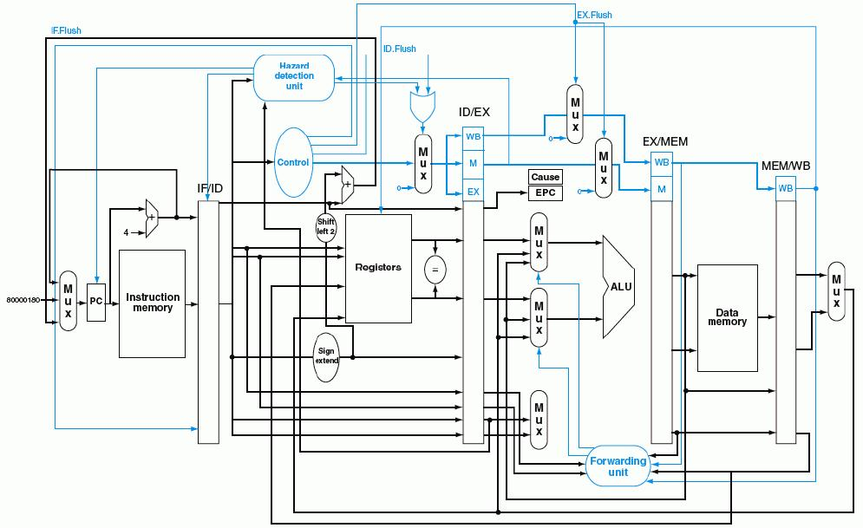
带异常处理的流水线数据通路
Overflow
80000180H

Slide 89
流水线方式下的异常处理的难点问题
流水线中同时有5条指令，到底是哪一条发生异常？
  根据异常发生的流水段可确定是哪条指令，因为各类异常发生的流水段不同
    “溢出”在EXE段检出
    “无效指令”在ID段检出
    “除数为0”在ID段段检出
    “无效指令地址”在IF段检出
    “无效数据地址”在Load/Store指令的EXE段检出
外部中断与特定指令无关，如何确定处理点？
  可在IF段或WB段中进行中断查询，需要保证当前WB段的指令能正确完成，并在有中断发生时，确保下个时钟开始执行中断服务程序
检测到异常时，指令已经取出多条，当前PC的值已不是断点，怎么办？
  指令地址存放在流水段R，可把这个地址送到EPC保存，以实现精确中断
  （非精确中断不能提供准确的断点，而由操作系统来确定哪条指令发生了异常）
一个时钟周期内可能有多个异常，该先处理哪个？
  异常：检出异常后，存到专门寄存器中（前面指令优先级高？）
  中断：在中断查询程序或中断优先级排队电路中按顺序查询
系统中只有一个EPC，多个中断发生时，一个EPC不够放多个断点，怎么办？
  总是把优先级最高的送到EPC中
在异常处理过程中，又发生了新的异常或中断，怎么办？
  利用中断屏蔽和中断嵌套机制来处理
  后面三个问题在第九章中详细介绍！

Slide 90
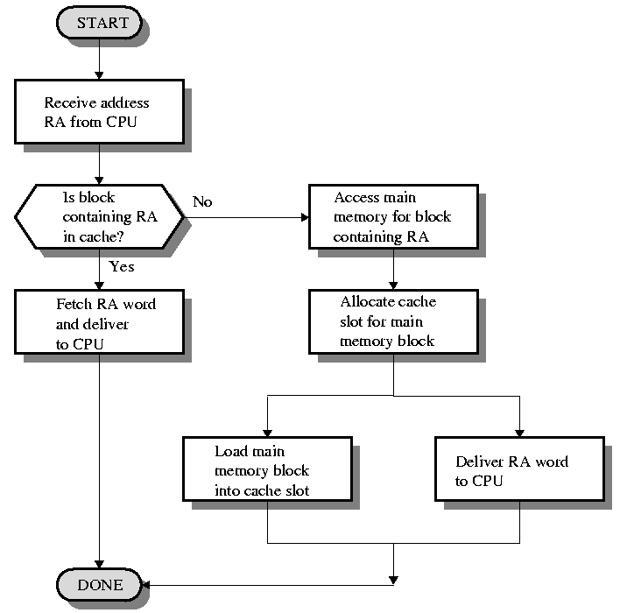
复习：Cache 的操作过程
硬件如何进行缺失处理？
如果被访问的信息不在cache中，称为失效(miss)
缺失处理
如果被访问的信息在cache中，称为命中(hit)

Slide 91
Cache缺失处理会引起流水线阻塞（停顿）
在使用Cache的系统中，数据通路中的IM和DM分别是Code Cache和Data Cache
CPU执行指令过程中，取指令或取数据时，如果发生缺失，则指令执行被阻塞
Cache缺失的检测（如何进行的？记得吗？）
  Cache中有相应的检测线路（地址高位与Cache标志比较）
阻塞处理过程
  冻结所有临时寄存器和程序员可见寄存器的内容（即：使整个计算机阻塞）
  由一个单独的控制器处理Cache缺失，其过程 (假定是指令缺失) 还记得吗？：
    把发生缺失的指令地址（PC- 4）所在的主存块首址送到主存
    启动一次“主存块读”操作，并等待主存完成一个主存块(Cache行)的读操作
    把读出的一个主存块写到Cache对应表项的数据区
    （若对应表项全满的话，还要考虑淘汰掉一个已在Cache中的主存块）
    把地址高位部分（标记）写到Cache的“tag”字段，并置“有效位”
    重新执行指令的第一步：“取指令”
  若是读数据缺失，其处理过程和指令缺失类似
    从主存读出数据后，从“取数”那一步开始重新执行就可以了
  若是写数据缺失，则要考虑用哪种“写策略”解决“一致性”问题
比数据相关或分支指令引起的流水线阻塞简单：只要保持所有寄存器不变
与中断引起的阻塞处理不同：不需要程序切换

Slide 92
TLB缺失和缺页也会引起流水线阻塞
TLB缺失处理
  当TLB中没有一项的虚页号与要找的虚页号相等时，发生TLB miss
  TLB miss说明可能发生以下两种情况之一：
    页在内存中：只要把主存中的页表项装载到TLB中
    页不在内存中(缺页)：OS从磁盘调入一页，并更新主存页表和TLB
缺页（page fault）处理
  当主存页表的页表项中“valid”位为“0”时，发生page fault
  Page fault是一种“故障”异常，按以下过程处理（MIPS异常处理）
    在Cause寄存器置相应位为“1”
    发生缺页的指令地址（PC- 4）送EPC
    0x8000 0180(异常查询程序入口)送PC
      执行OS的异常查询程序，取出Cause寄存器中相应的位分析，得知发生了“缺页”，转到“缺页处理程序”执行
  page fault一定要在发生缺失的存储器操作时钟周期内捕获到，并在下个时钟转到异常处理，否则，会发生错误。
    例：lw $1, 0($1) ，若没有及时捕获“异常”而使$1改变，则再重新执行该指令时，所读的内存单元地址被改变，发生严重错误！
处理Cache缺失和缺页的不同之处在哪里？
哪种要进行程序切换？

Slide 93
（缺页）异常处理时要考虑的一些细节
缺页异常结束后，回到哪里继续执行？
  指令缺页：重新执行发生缺页的指令
  数据缺页：
    简单指令（仅一次访存）：强迫指令结束，重新执行缺页指令
    复杂指令（多次访存）：可能会发生多次缺页，指令被中止在中间某个阶段，缺页处理后，从中间阶段继续执行；因而，需要能够保存和恢复中间机器状态
异常发生后，又发生新的异常，怎么办？
  在发现异常、转到异常处理程序中，若在保存正在运行进程的状态时又发生新的异常，则因为要处理新的异常，会把原来进程的状态和保存的返回断点破坏掉，所以，应该有一种机制来“禁止”响应新的异常处理
  通过“中断/异常允许”状态位（或“中断/异常允许”触发器）来实现
  “中断/异常允许”状态位置1，则“开中断”（允许异常），清0则“关中断 ”（ 禁止异常）
  也可由OS通过管态指令来设置该位的状态

Slide 94
三种处理器实现方式的比较
单周期、多周期、流水线三种方式比较
假设各主要功能单元的操作时间为：
存储单元：200ps
ALU和加法器：100ps
寄存器堆（读 / 写）：50ps
假设MUX、控制单元、PC、扩展器和传输线路都没有延迟，指令组成为：
25%取数、10%存数、52%ALU、11%分支、2%跳转
则下面实现方式中，哪个更快？快多少？
（1）单周期方式：每条指令在一个固定长度的时钟周期内完成
（2）多周期方式：每类指令时钟数:取数-5，存数-4，ALU-4，分支-3，跳转-3
（3）流水线方式：每条指令分取指令、取数/译码、执行、存储器存取、写回五阶段
（假定没有结构冒险，数据冒险采用转发处理，分支延迟槽为1，预测准确率
为75%；不考虑异常、中断和访问缺失引起的流水线冒险）

Slide 95
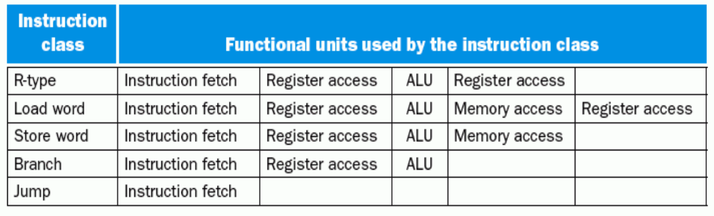
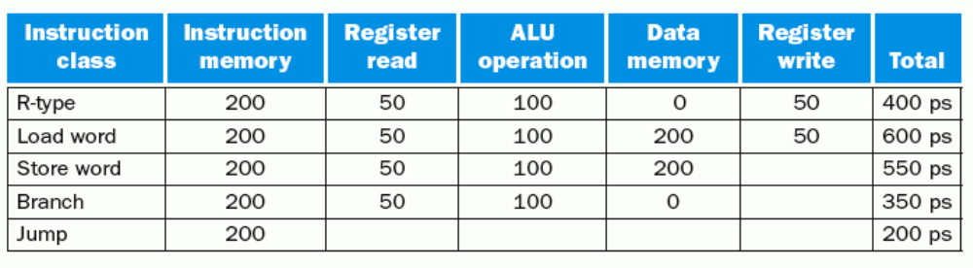
三种处理器实现方式的比较
解：CPU执行时间=指令条数 x CPI x 时钟周期长度
三种方式的指令条数都一样，所以只要比较CPI和时钟周期长度即可。
各指令类型要求的时间长度为：

Slide 96
三种处理器实现方式的比较
对于单周期方式：
时钟周期将由最长指令来决定，应该是load指令，为600ps
所以，N条指令的执行时间为600N(ps)
对于多周期方式：
时钟周期将取功能部件最长所需时间，应该是存取操作，为200ps
根据各类指令的频度，计算平均时钟周期数为：
CPU时钟周期=5x25%+4x10%+4x52%+3x11%+3x2%=4.12
所以， N条指令的执行时间为4.12x200xN=824N(ps)
对于流水线方式：
Load指令：当发生Load-use依赖时，执行时间为2个时钟，否则1个时钟，故平均执行时间为1.5个时钟；
Store、ALU指令：1个时钟；
Branch指令：预测成功时，1个时钟，预测错误时，2个时钟，
所以：平均约为：.75x1+.25x2=1.25个；
Jump指令：2个时钟（总要等到译码阶段结束才能得到转移地址）
平均CPI为：1.5x25%+1x10%+1x52%+1.25x11%+2x2%=1.17
所以， N条指令的执行时间为1.17x200xN=234N(ps)

Slide 97
流水线冒险对程序性能的影响
结构冒险对浮点运算的性能影响较大，因为浮点运算单元不能有效被流水化，可能造成运算单元的资源冲突
控制冒险更多出现在整数运算程序中，因为分支指令对应于循环或选择结构，大多由整数运算结果决定分支
数据冒险在整数运算程序和浮点运算程序中都一样
  浮点程序中的数据冒险容易通过编译器优化调度来解决
    分支指令少
    数据访问模式较规则
  整数程序的数据冒险不容易通过编译优化调度解决
    分支指令多
    数据访问模式不规则
    过多使用指针

Slide 98
第二讲小结
流水线冒险的几种类型：
  资源冲突、数据相关、控制相关（改变指令流的执行方向）
数据冒险的现象和对策
  数据冒险的种类
    相关的数据是ALU结果，可以通过转发解决
    相关的数据是DM读出的内容，随后的指令需被阻塞一个时钟
  数据冒险和转发
    转发检测 / 转发控制
  数据冒险和阻塞
    阻塞检测 / 阻塞控制
控制冒险的现象和对策
  静态分支预测技术
  缩短分支延迟技术
  动态分支预测技术
异常和中断是一种特殊的控制冒险
访存缺失（Cache缺失、TLB缺失、缺页）会引起流水线阻塞

Slide 99
第三讲 高级流水线技术
高性能流水线 - 指令级并行(ILP)技术
  超流水线
  多发射流水线
    静态多发射（VLIW处理器+编译器静态调度）
    动态多发射（超标量处理器+动态流水线调度）
静态多发射（VLIW-超长指令字）
  编译器静态推测完成“指令打包”和“冒险处理”
  MIPS 2-发射流水线数据通路
  循环展开指令调度
  IA-64的EPIC技术
动态多发射
  动态多发射流水线的通用模型
  动态多发射流水线的执行模式
    按序发射、按序完成
    按序发射、无序完成
    无序发射、无序完成
  Pentium 4 动态多发射流水线
    超流水、超标量、动态调度、无序发射、无序完成

Slide 100
提高性能措施—实现指令级并行
流水线实现了指令流内部的并行，这种并行称为指令级并行（ILP）
有两种指令级并行策略
  超流水线（Super- pipelining）
    级数更多的流水线
    理想情况下，流水线的加速比与流水段的数目成正比
    （即：理想情况下，流水段越多，时钟周期越短，指令吞吐率越高）
    但是，它是有极限的！可以怎样突破极限呢？
  多发射流水线（Multiple issue pipelining ）
    多条指令(如整数运算、浮点运算、装入/存储等) 同时启动并独立运行
    前提：有多个执行部件。如：定点、浮点、乘/除、取数/存数部件等
    结果：能达到小于1的CPI，定义CPI的倒数为IPC
    （例如：四路多发射流水线的理想IPC为4）
    需要实现以下两个主要任务
      指令打包：分析每个周期发射多少条？哪些指令可以同时发射？
      冒险处理：由编译器静态调整指令或在运行时由硬件处理
    实现上述两个主要任务的基础—推测技术
    两种实现方法
      静态多发射：由编译器在编译时静态完成指令打包或冒险处理
      动态多发射：由硬件在执行时动态完成指令打包或冒险处理
CPI=？
CPI=1

Slide 101
实现多发射技术的基础—推测
推测技术：由编译器或处理器猜测指令执行结果，并以此来调整指令执行顺序，使指令的执行能达到最大可能的并行
  指令打包的决策依赖于“推测”的结果
    可根据指令间的相关性来进行推测
      与前面指令不相关的指令可以提前执行
    可对分支指令进行推测
      可提前执行分支目标处的指令
    预测仅是“猜测”，有可能推测错误，故需有推测错误检测和回滚机制
    推测错误时，会增加额外开销
  有“软件推测”和“硬件推测”两种
    软件推测：编译器通过推测来静态重排指令（一定要正确！）
    硬件推测：处理器在运行时通过推测来动态调度指令
BACK

Slide 102
静态多发射处理器
由编译器在编译时，进行相关性分析和静态分支预测，以静态完成“指令打包”或“冒险处理”
  指令打包（将同时发射的多条指令合并到一个长指令中）
    将一个周期内发射的多个指令看成一条多个操作的长指令，称为一个“发射包”
    “静态多发射”最初被称为“超长指令字”（VLIW-Very Long Instruction Word），采用这种技术的处理器被称为VLIW处理器
    在同一个周期内发射的指令类型是受限制的
    （例如，只能是一条ALU指令/分支指令、一条Load/Store指令）
    IA-64采用这种方法，Intel称其为EPIC（Explicitly Parallel Instruction Computer—显式并行指令计算机）
  冒险处理（主要是数据冒险和控制冒险）
    做法1：完全由编译器通过代码调度和插入nop指令来消除所有冒险，无需硬件实现冒险检测和流水线阻塞
    做法2：由编译器通过静态分支预测和代码调度来消除同时发射指令间内部依赖，由硬件检测数据冒险并进行流水线阻塞
即：保证打包指令内部不会出现冒险！

Slide 103
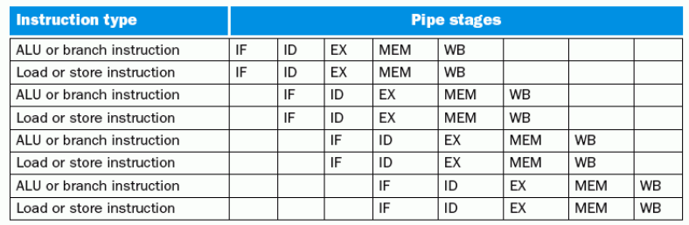
静态多发射处理器实例
实例：MIPS ISA 指令集的静态多发射----2发射处理器
要使原来的MIPS处理器能够同时处理两条流水线，数据通路需要做哪些改进？
1. 同时要能取并译码两条指令，怎么办？
将两条指令打包成64位长指令，前面为ALU/Branch，后面为lw/sw
没有配对指令时，就用nop指令代替
将64位长指令中的两个操作码同时送到控制器（指令译码器）进行译码
2. 两条指令同时要读两个寄存器或写寄存器（和lw配对时） ，怎么办？
增加两个读口和一个写口
3. 两条指令同时要使用ALU进行运算 ，怎么办？
BACK
增加一个ALU（包括2组输入总线和1组输出总线）

Slide 104
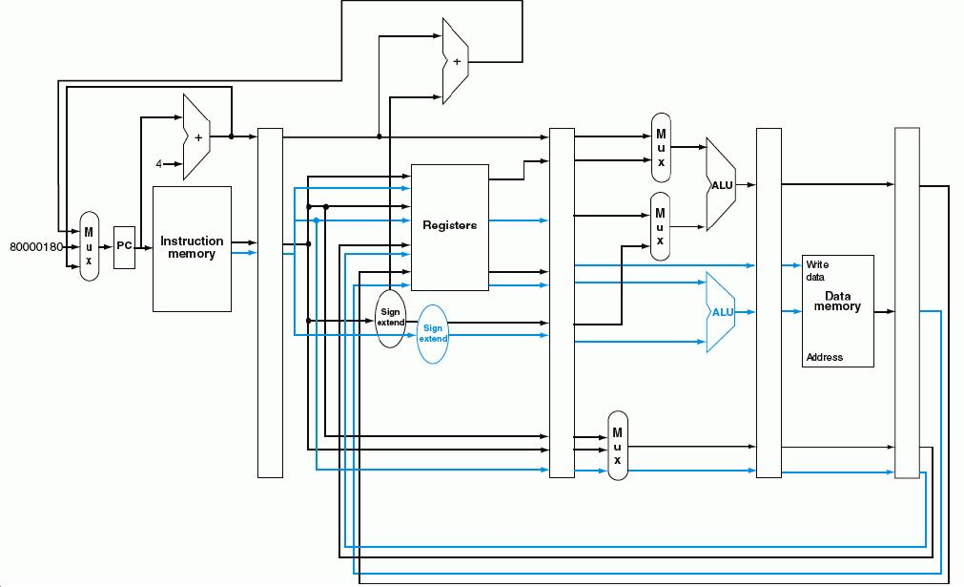
2发射流水线数据通路（蓝色是增加部分）
需增加额外加法器或ALU
ALU/分支指令进行ALU运算时，
Load/Store指令要计算地址
指令成对放在64位对齐内存区域，前面是ALU/分支指令。如果不能成对，则用nop指令代替缺失指令，每次取两条指令，同时对两条指令译码
同时需为ALU和lw/sw指令读两个寄存器，同时需为ALU运算和Load结果写一个寄存器
控制器和控制信号会要求数据通路怎样改呢？
流水段寄存器要增宽，控制信号分别传送。

Slide 105
2发射流水线的特点
优点：潜在性能将提高大约2倍 （实际上达不到！为什么？ ）
缺点：
  为消除结构冒险，需增加额外部件
  增加潜在的由数据冒险和控制冒险导致的性能损失
    例1：对于Load-use数据冒险
      单发射流水线：只有一条指令延迟
      2发射流水线：有一个周期（2条指令）延迟
    例2：对于ALU-Load/Store数据冒险
      单发射流水线：可用“转发”技术使ALU结果直接转发到Load/Store指令的EXE阶段
      2发射流水线：两条指令同时进行，ALU的结果不能直接转发，因而不能提供给与其配对的Load/Store指令使用，只能延迟一个周期
为了更有效地利用多发射处理器的并行性，必须有更强大的编译器，能够充分消除指令间的依赖关系，使指令序列达到最大的并行性！

Slide 106
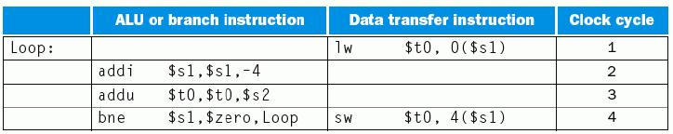
例：2发射MIPS指令调度
前三条和后两条各具有相关性
可把第四条指令调到第一条后面sw指令是否有问题？怎么办？
以下是一段循环代码段
  Loop: lw $t0, 0($s1)
  addu $t0, $t0, $s2
  sw $t0, 0($s1)
  addi $s1, $s1, -4
  bne $s1, $zero, Loop
(能看出这段程序的功能吗？)
为了能在2发射MIPS流水线中有效执行，该怎样重新排列指令
  调度方案如下：没有指令配对时，用nop指令代替
$s1减4，故sw指令偏移改为4
能否把addi和lw配成一对？
冒险！对同一个寄存器同时读，且读后要写，取决于寄存器如何设计
循环内进行的是数组访问！
一个循环内，五条指令在四个时钟内完成，实际CPI为0.8，即: IPC=1.25
在循环中访问数组的更好的调度技术是“循环展开”

Slide 107
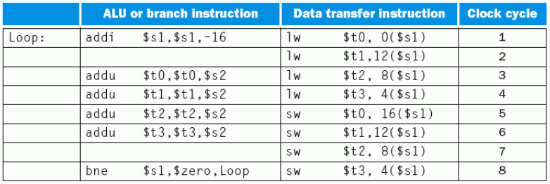
用“循环展开”技术进行指令调度
基本思想：展开循环体，生成多个副本，在展开的指令中统筹调度
上例采用“循环展开”后的指令序列是什么？
  为简化起见，假定循环执行次数是4的倍数
  “循环展开”4次后循环内每条指令（lw, addu, sw，与数组访问相关）有4条再加上1条addi和1条bne, 共14条指令
  指令最佳调度序列如下：
为何第一条指令将$s1减16？与$t0关联的指令偏移为何不同？
14条指令用了8个时钟，CPI达到8/14=0.57。
需要用到“重命名寄存器”技术，多用了三个临时寄存器$t1,$t2,$t3，消除了名字依赖关系（非真实依赖，只是寄存器名相同而已）
代价是什么？
好处：充分利用并行，并消除部分循环分支！
多用了三个临时寄存器，并增加了代码大小（存储空间变大）

Slide 108
循环展开后的偏移量
第一条指令将$s1减16，使指令执行后，$s1的值变成了循环结束时$s1的值
所以循环体内各数组元素的访问指令的偏移量依次为：
  16 - 数组元素1，12 - 数组元素2 ，8 - 数组元素3，4 - 数组元素4
$s1-16
为什么第一个周期中的lw指令的偏移量为0?
因为第一个周期中的lw指令进行地址计算时，addi指令的执行结果还没有写到$s1中，所以，此时$s1中还是原来的值?
数组元素4
数组元素3
为什么第一条addu指令不放在第二周期?
为了避免load-use数据冒险！
数组元素2
当循环次数不是4的倍数时，这样做就有问题！
可见：编译器和机器结构密切相关！系统程序员必须非常了解机器结构！编译器的好坏直接影响机器的性能！
数组元素1
$s1

Slide 109
实例：Intel IA-64架构
IA-64类似于64位MIPS架构，是Register-Register型的RISC风格指令集
但有独特性：要求编译器显式地给出指令级的并行性，Intel称其为EPIC
  Explicitly Parallel Instruction Computer—显式并行指令计算机
与MIPS-64架构的区别
  更多寄存器：128个整数、128个浮点数、8个专用分支、64个1位谓词
  支持寄存器窗口重叠技术
  同时发射的指令组织在指令包（bundle）中
  引入特殊的谓词化技术，以支持推测执行和消除分支，提高指令级并行度
EPIC的实现技术
  指令组（Instruction Group）：相互间没有寄存器级数据依赖的指令序列
    指令组长度任意，用“停止标记”在指令组之间明显标识
    指令组内部的所有指令可并行执行，只要有足够硬件且无内存操作依赖
  指令包：同时发射的指令重新编码并形成指令包
    长度为128，由5位长的模板字段、三个41位长的指令组成
    模板字段对应于以下五类功能部件中的三条指令
      整数ALU、非整数ALU（移位和多媒体）、访存、浮点、分支
  谓词化：将指令的执行与谓词相关联，而不是与分支指令关联
IA-64是?-发射流水线？
3-发射流水线！
BACK

Slide 110
RISC的通用寄存器
RISC机采用大量寄存器
其目的：
  减少程序访问存储器的次数
RISC机寄存器的组织方式有两种：
  重叠寄存器窗口技术ORW（硬件方法）
    执行过程调用和返回时，利用寄存器组而不是存储器来完成参数传递
    通过重叠窗口技术，使得不再需要保存和恢复寄存器内容
    可大大提高了程序执行的速度
  优化寄存器分配技术（软件方法）
    规定一套寄存器分配算法
    通过编译程序的优化处理来充分利用寄存器资源
    编译器为那些在一定的时间内使用最多的变量分配寄存器
BACK

Slide 111
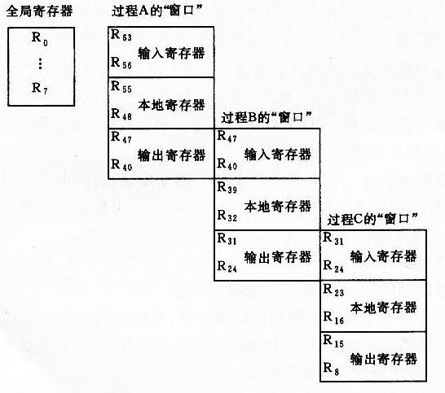
重叠寄存器窗口技术（Overlapped Register Window ）
用于保存局部数据
与调用自己的父过程的输出寄存器重叠
寄存器分为两类：
全局寄存器：所有过程共享
窗口寄存器：用于过程调用
与被调用子过程的输入寄存器重叠
A调用B时，由于各自使用不同的局部寄存器，所以不需保存现场
A过程的输出寄存器可直接把参数送给B
从B返回时，B将返回结果送到其输入寄存器，A可直接得到B返回的结果
BACK

Slide 112
Intel IA-64架构的谓词和推测执行技术
谓词和谓词寄存器
  分支指令中的条件称为谓词
  每个谓词与一个谓词寄存器相关联
  每条指令都可与最后6位标识（64个一位谓词，故谓词寄存器的标号用6位表示）的谓词寄存器相关联，反映条件是否满足
可消除循环内if-then-else分支（循环分支可由循环展开部分消除）
  例：if (p) { Statement1 } else { Statement2 } 被编译成：
  (p) Statement1
  (~p) Statement2
  括号中的条件为1时，执行后面的代码，否则，转化为nop指令
条件分支指令被转化为由谓词寄存器关联的指令，消除了分支
通过谓词寄存器可实现指令的推测执行
IA-64是采用静态多发射机制的最复杂指令集，对编译器的要求极高
BACK

Slide 113
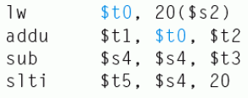
动态多发射处理器
由硬件在执行时动态完成指令打包或冒险处理
通常被称为超标量处理器（Superscalar）
  在一个周期内执行一条以上指令
与VLIW处理器的不同点：
  VLIW处理器：编译结果与机器结构密切相关，结构有差异的机器上要重新编译
  超标量处理器：编译器仅进行指令顺序调整，但不进行指令打包，由硬件根据机器的结构来决定一个周期发射哪几条指令。因此，编译后的代码能够被不同结构的机器正确执行
多数超标量处理器都结合动态流水线调度（Dynamic pipeline scheduling）技术
  通过指令相关性检测和动态分支预测等手段，投机性地不按指令顺序执行，当发生流水线阻塞时，可以到后面找指令来执行
  举例说明动态流水线调度技术：
左边指令序列中，哪条指令可以提前执行？
sub指令可以提前执行，不需等lw和addu指令执行完
如果不将sub调到前面，可能要等很长时间（lw指令的访存操作耗时较长！），从而影响slti指令的执行
最佳的方案是什么？
SKIP

Slide 114
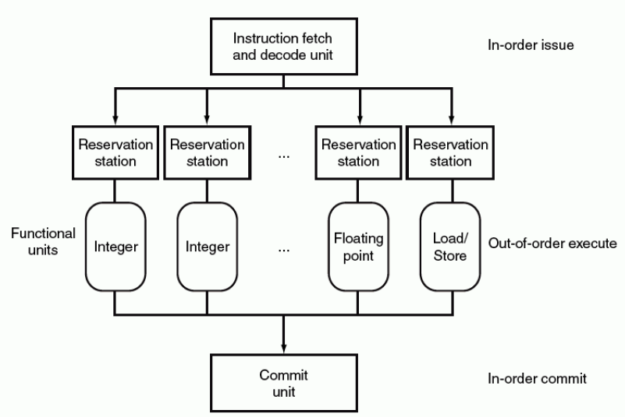
动态流水线调度的通用模型
动态流水线的一个重要的思想：在等待解决阻塞时，到后面找指令提前执行！
动态流水线的通用模型：
  一个指令预取和译码单元：有序发射
  多个并列执行的功能单元：乱序执行
  一个提交单元：有序提交
每个功能单元有各自的保留站
用于保存操作数和操作命令
功能单元一旦完成，则将结果同时送其他等待该结果的保留站和提交单元
提交单元缓存所有完成的指令结果，直到该结果能安全写回到寄存器或存储器，称为Reorder Buffer
指令的结果也可在Reorder Buffer中被“转发”

Slide 115
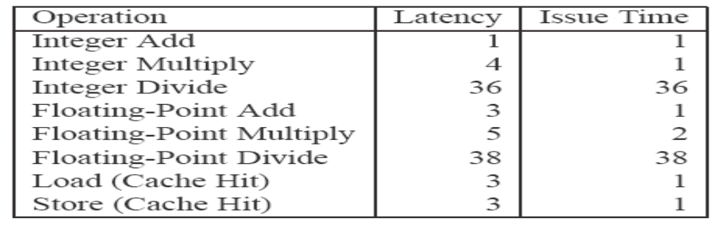
功能单元的性能
功能：用来执行特定类型的操作
性能：每个功能单元具有基本的操作性能，用两个周期数来刻画
  执行周期（Latency）：完成特定操作所花的周期数
  发射时间（Issue Time）：连续、独立操作之间的最短周期数
  以下是Pentium III 算术功能部件的性能
从上述图中看出，哪些功能部件是流水化的？哪些是非流水化的？
  整数加、整数乘、浮点加、装入、存储这五种部件是流水化的
  浮点乘部件是部分流水化
  整数除和浮点除是完全没有流水化
CPU设计的一个原则：有限的芯片空间应该在各功能部件之间进行平衡！尽量让大多数资源用于最关键的操作（对大量基准程序进行评估）
从上述图中能否看出：哪些是最重要的操作？哪些是不常用的？
  整数加法和乘法、浮点数加法和乘法是重要的操作
  除法相对来说不太常用，而且本身难以实现流水线

Slide 116
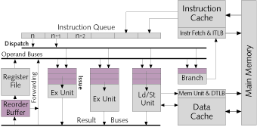
动态流水线的几种执行模式
根据动态流水线指令发射和完成顺序，可分为三种执行模式：
  按序发射按序完成（Pentium）
  按序发射无序完成（Pentium II和Pentium III）
  无序发射无序完成（Pentium 4）
最保守的方案是顺序完成，好处：
简化异常检测和异常处理
能在被推测指令完成前得知推测结果的正确性
写回条件：与前面的所有指令结果不相关、并预测正确
ReOrder Buffer 重排序缓冲:
用于保存已完成的指令结果，等待在可能时写回寄存器堆
指令发射时，其操作数可能在寄存器堆或ROB中，可立即复制到保留站中，故源操作数寄存器可被覆盖
若操作数不在寄存器堆或ROB中，则一定在某个时刻被一个功能单元计算出来，硬件将定位该功能单元，并将结果从旁路寄存器复制到保留站
保留站：存放操作数和操作命令
SKIP

Slide 117
按序发射按序完成
举例：2发射超标量，分为取指（F）、译码（D）、执行（E）、写回（W）。F、D、W段在一个时钟周期内完成（可同时有两条指令在这三个阶段）；E段有三个执行部件：Load/Store部件完成数据Cache访问需要1个时钟，整数ALU完成简单ALU操作需2个时钟，整数乘法器完成乘法运算需要3个时钟。执行部件采用流水化方式。
按序发射按序完成的过程如下：
指令被阻塞在“译码器”中
译码段
执行段
写回段
时钟
i1 lw $1, A
i2 add $2, $2, $1
i3 add $3, $3, $4
i4 mul $4, $5, $4
i5 lw $6, B
i6 mul $6, $6, $7
i1
i2
2
i2
i1
3
i3
i4
i2
i1
4
i5
i6
i2
i3
i4
5
i6
i5
i3
i4
i2
6
[i5]
i4
i6
i3
7
i1、i2间RAW; i5、i6间RAW和WAW，需阻塞一个时钟周期，并一定要按序完成！
[i5]
i6
i4
8
为了按序完成，虽然i5在时钟6已经完成，但一直推迟到i4写回后的第9时钟才写回
i6
i5
9
L/S
ALU
Mul
i6
10
如果还有一条乘法指令，则最多可有三条乘法指令同时在执行
BACK

Slide 118
按序发射无序完成
举例：2发射超标量，分为取指（F）、译码（D）、执行（E）、写回（W）。F、D、W段在一个时钟周期内完成（可同时有两条指令在这三个阶段）；E段有三个执行部件：Load/Store部件完成数据Cache访问需要1个时钟，整数ALU完成简单ALU操作只需2个时钟，整数乘法器完成乘法运算需要3个时钟。执行部件采用流水化方式。
按序发射无序完成的过程如下：
译码段
执行段
写回段
时钟
i1 lw $1, A
i2 add $2, $2, $1
i3 add $3, $3, $4
i4 mul $4, $5, $4
i5 lw $6, B
i6 mul $6, $6, $7
i1
i2
2
i2
i1
3
i3
i4
i2
i1
4
i5
i6
i2
i3
i4
5
i6
i5
i3
i4
i2
6
[i5]
i4
i6
i3
i5
7
无序完成时，因为i5在时钟6已经完成，和i3、i4没有相关性，可以不需要等i3、i4写回后再写回，所以可先于i4完成。
[i5]
i6
i4
8
i6
9
L/S
ALU
Mul
i6
10
BACK

Slide 119
无序发射无序完成
举例：2发射超标量，分为取指（F）、译码（D）、执行（E）、写回（W）。F、D、W段在一个时钟周期内完成（可同时有两条指令在这三个阶段）；E段有三个执行部件：Load/Store部件完成数据Cache访问需要1个时钟，整数ALU完成简单ALU操作只需2个时钟，整数乘法器完成乘法运算需要3个时钟。执行部件采用流水化方式。
无序发射无序完成的过程如下：
取指和译码按顺序进行，发射前进行相关性检测，无关指令可先行发射和先行完成!
例如：i4在i3前面发射！
i1 lw $1, A
i2 add $2, $2, $1
i3 add $3, $3, $4
i4 mul $4, $5, $4
i5 lw $6, B
i6 mul $6, $6, $7
译码段
执行段
写回段
时钟
i1
i2
2
i3
i4
i1
3
i5
i6
i2
i4
i1
4
i7
i8
i5
i2
i3
i4
5
i3
i4
i6
i2
i5
6
无序发射的超标量中，译码后的指令被存放在一个“指令窗口”的缓冲器中，等待发射.当所需功能部件可用、且无冲突或无相关性阻碍指令执行时，就从指令窗口发射，与取指和译码的顺序无关。
i6
i3
i4
7
i6
8
i6
9
L/S
ALU
Mul
10
只要保证i1和i2、i5和i6之间的发射和完成顺序即可！
BACK

Slide 120
动态流水线调度的必要性
编译器可以依据数据依赖关系来调度代码，为什么还要超标量处理器来动态调度？
  并不是所有阻塞都能事先确定，动态调度可在阻塞时，提前执行无关指令
    例如，Cache缺失是不可预见的阻塞
  动态分支预测需要根据执行的真实情况进行预测
  采用动态调度使得硬件将处理器细节屏蔽起来
  （不同处理器的发射宽度、流水线延时等可能不同，流水线的结构也会影响循环展开的深度。通过动态调度使得处理器细节屏蔽起来，软件发行商无需针对同一指令集的不同处理器发行相应的编译器，并且，以前的代码也可在新的处理器上运行，无需重新编译）
理解程序的性能：
高性能微处理器并不能持续进行多条指令的发射，原因有：
指令间的高度依赖关系限制了指令之间的并行执行，特别是隐含依赖关系的存在。例如，使用指针的代码段，存在隐含依赖。
分支指令预测错误。
内存访问引起的阻塞（Cache缺失、缺页等）使得流水线难以满负荷运转。

Slide 121
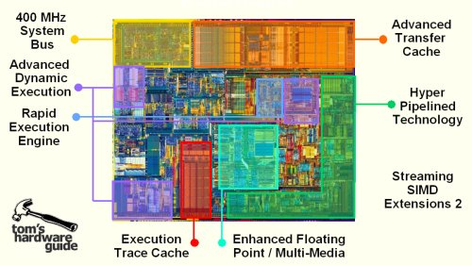
回顾：Pentium 4 处理器的芯片布局
前端总线及其接口
L1数据cache
L2 cache
高级动态执行
超级流水线
技术
定点运算器
Trace cache
(L1指令cache)
浮点运算器
MMX

Slide 122
回顾：Pentium 4 处理器的逻辑结构
BTB1静态预测从L2的何处预取指令
64位,时钟频率
指令预取部件
分支预测器BTB1
前端总线
简单指令直接译码成1~4条微操作；复杂指令从微码ROM中取
BTB2动态预测从trace cache的何处取微操作
指令译码器
微码ROM
执行跟踪cache
(12000微操作)
分支预测器BTB2
总线
接口部件
微操作队列
微操作队列
预取
控制逻辑
整 数 寄 存 器 组
浮 点 寄 存 器 组
慢ALU
2xALU
2xALU
2xAGU
2xAGU
浮点存
浮 点 取
浮点加
浮点乘
浮点除
SSE/
SSE2
L2
cache
(48GB/s)
复杂指令
简单指令
简单指令
MMX
存地址
取地址
256位，时钟频率
L1数据cache(8KB)

Slide 123
Pentium 4的超标量结构运算器
整 数 寄 存 器 组
浮 点 寄 存 器 组
慢ALU
2xALU
2xALU
2xAGU
2xAGU
SSE
SSE2
SSE3
浮点 存
浮 点 取
浮点加、减、乘、除等运算
MMX
复杂
指令
简单指令
简单指令
存地址
取地址
L1数据cache(8KB)
采用超标量（superscalar）结构，一共包含9个运算部件，可同时工作，所花时钟不同
  2个高速整数ALU(每个时钟周期进行2次操作)， 用于完成简单的整数运算(如加、减法)
  1个慢速整数ALU(需要多个时钟周期才能完成1次操作)，用于完成整数乘、除法运算
  2个地址生成部件（AGU），用于计算操作数的有效地址，所生成的地址分别用于从内存取操作数或向内存保存操作结果
  1个运算部件用于完成浮点操作数地址的计算
  1个运算部件用于完成浮点加法、乘法和除法运算
  1个运算部件用于执行流式的SIMD处理（SSE/SSE2/SSE3指令）
  1个运算部件用于完成多媒体信号处理（MMX指令）
在运算部件中执行的是微操作，而不是指令！运算器中的操作采用流水方式！

Slide 124
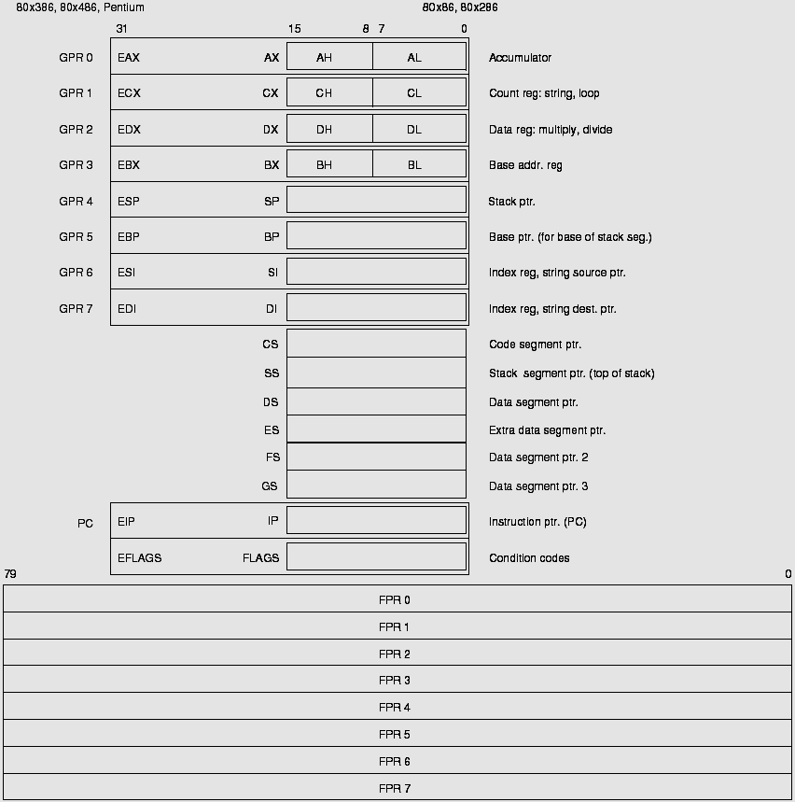
回顾：Pentium 4 的用户可见寄存器组
整数寄存器组
P4 Pentium 80386 80486 8086 8088
在Pentium4内部，整数和浮点数各有128个寄存器
寄存器换名操作：将用户可见的外部逻辑寄存器换成内部的物理寄存器
寄存器换名时，要确定是真实依赖还是名字依赖（反依赖）
名字依赖时可用不同的物理寄存器替换相同的逻辑寄存器
指令计数器
标志寄存器
浮点寄存器组

Slide 125
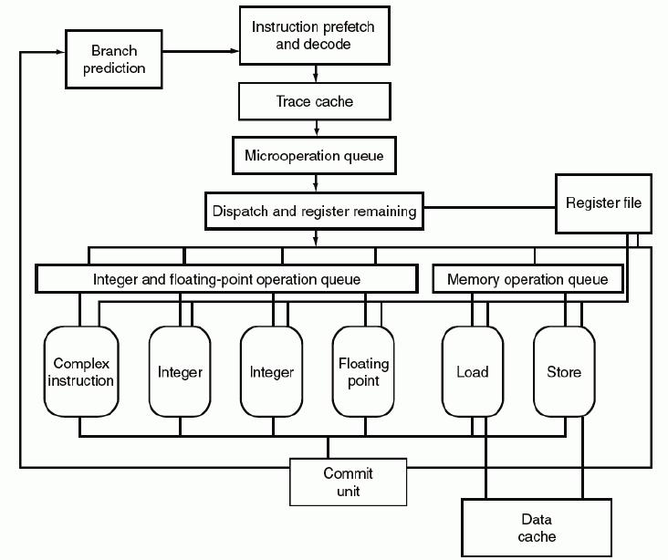
Pentium4 流水线结构部分
每个MOP相当于一条RISC指令
但其格式没有公开
指令译码结果是对应的若干条微操作MOP
TraceCache存放指令对应的微操作序列，一条分支微操作序列称为一个踪迹（trace），TC中有多条trace，动态预测将哪条trace送MOP队列(126项ROB)
分配资源（内部寄存器、缓冲器）并重命名后将MOP分别送两个不同队列
ROB各项中记录对应MOP的资源分配状态
整数/浮点队列和存储队列各自有调度器，用于检测相关性，无序发射
Pentium 4是“CISC壳、RISC核”结构
从TC中取MOP开始，进入MOP的20级超标量超流水线

Slide 126
Pentium 4的指令译码 – 对指令功能进行分解
指令译码逻辑：
  功能：将指令转换为一组基本操作，称为微操作MOP
  输入：程序中的指令
  输出：微操作（简单计算任务）
例1：addl %eax, %edx 的译码结果为什么？
一个“加法”操作（对应一个微操作MOP）
例2：addl %eax, 4 (%edx) 的译码结果呢？
四个简单操作（对应四个微操作MOP）：
“地址计算”：Reg[%edx]+4->addr
“装入”：Mem[addr]->Reg[Rtemp]
“加法”：Reg[Rtemp]+Reg[%eax]->Reg[Rtemp]
“存数”：Reg[Rtemp]->Mem[addr]
一个微操作相当于一条RISC指令，译码生成的微操作序列被存放到Trace Cache中

Slide 127
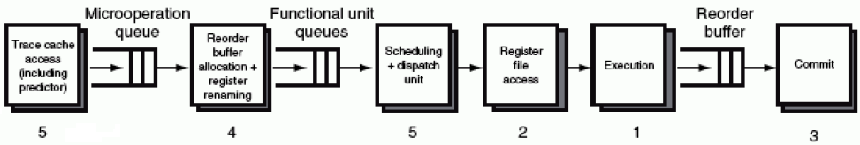
Pentium4 的20级超流水线(Hyper-pipeline)
整数运算微操作流水线为20级，浮点为29级（执行阶段的长度不同）
两个drive段用于芯片内传输信号的驱动，使其保证长距离传输
沿一个踪迹顺序取MOP，直到遇到一条转移MOP，通过BTB2预测下个踪迹开始点，继续取MOP送ROB/Alloc/Ren部件。预测目标处MOP不在时，要通知指令预取器，快从L2中取指令并译码。
一个周期3条MOP送ROB。ROB有126项，记录每个MOP及分配的资源和执行状态，根据资源分配情况进行寄存器重命名后，分别送两个MOP队列中进行排队。
每个队列按FIFO
将MOP送到各自
的调度器，在调
度器中进行数据
相关性检测，当
所有源操作都就
绪时，将MOP发
射到对应的执行
部件。是“无序”
发射。
被发射的MOP开始读取物理寄存器中的源操作数，或从旁路由L1-D Cache读取。
建立标志信
息ZF/CF等，
并将执行结
果写入物理
寄存器。
对BTB2中
预测是否正
确进行确认
及相应处理
在不同的执行部件中执行。每个部件执行时间长短不同

Slide 128
本讲小结
有以下两种指令级并行(ILP)技术（即：高性能流水线形式）
  超流水线：更多的流水线级数
  多发射流水线：同时发射多个指令，有多条流水线同时进行
    静态多发射（VLIW处理器+编译器静态调度）
    动态多发射（超标量处理器+动态流水线调度）
静态多发射（VLIW（超长指令字）处理器）
  由编译器静态推测来完成“指令打包”和“冒险处理”
  MIPS 2-发射Datapath中有2个执行部件，将2条指令打包，并同时译码执行
  采用循环展开进行指令调度，能得到很好的性能
  IA-64采用VLIW级数，Intel特称其为EPIC技术，3条指令打包
动态多发射（超标量处理器）
  指令执行时由硬件动态推测，多个执行部件，同时发射多个指令到执行部件
  3种动态多发射流水线的执行模式
    按序发射按序完成、按序发射无序完成、无序发射无序完成
  Pentium 4 动态多发射流水线（无序发射、无序完成）
    简单指令由硬件译码器 + 复杂指令由微操作ROM 产生 MOP
    指令对应的MOP存放在 trace cache中，按一条条trace存放 （同一条指令对应的若干微操作可能存放在不同的trace中）
    20级以上超流水线、3发射超标量、2个队列动态调度、126条微操作同时执行
    指令静态预测 + 微操作动态预测

Slide 129
本章总结1
指令流水线的设计
  将每条指令的执行规整化为若干个同样的流水阶段
  每个流水阶段的执行时间一样，都等于一个时钟
  理想情况下，每个时钟有一条指令进入流水线，也有一条指令执行结束
  每个流水段中的部件都是组合逻辑加寄存器，组合逻辑中产生的结果在时钟到来时被存储到寄存器（如：程序计数器、条件码寄存器、流水线寄存器等）。
  每两个相邻流水段之间的流水线寄存器，用以记录所有在后面阶段要用到的各种信息，有哪些呢？
    控制信号、指令的代码、参加运算的操作数、指令运算结果、指令异常信息、寄存器读口地址、寄存器写口地址、存储器地址、新的PC值等。
  指令译码得到的控制信号通过流水线寄存器传送到后面各个流水段中

Slide 130
本章总结2
单周期, 多周期 和 流水线比较
Cycle 1
Cycle 2
Clk
Single Cycle Implementation:
Load
Store
Waste
Cycle 1
Cycle 2
Cycle 3
Cycle 4
Cycle 5
Cycle 6
Cycle 7
Cycle 8
Cycle 9
Cycle 10
Clk
Multiple Cycle Implementation:
Load
Store
R-type
Ifetch
Reg
Exec
Mem
Wr
Ifetch
Reg
Exec
Mem
Ifetch
Pipeline Implementation:
Load
Ifetch
Reg
Exec
Mem
Wr
Store
Ifetch
Reg
Exec
Mem
Wr
R-type
Ifetch
Reg
Exec
Mem
Wr
Notes:
Here are the timing diagrams showing the differences between the single cycle, multiple cycle, and pipeline implementations.
For example, in the pipeline implementation, we can finish executing the Load, Store, and R-type instruction sequence in seven cycles.
In the multiple clock cycle implementation, however, we cannot start executing the store until Cycle 6 because we must wait for the load instruction to complete.
Similarly, we cannot start the execution of the R-type instruction until the store instruction has completed its execution in Cycle 9.
In the Single Cycle implementation, the cycle time is set to accommodate the longest instruction, the Load instruction.
Consequently, the cycle time for the Single Cycle implementation can be five times longer than the multiple cycle implementation.
But may be more importantly, since the cycle time has to be long enough for the load instruction, it is too long for the store instruction so the last part of the cycle here is wasted.
+2 = 77 min. (X:57)

Slide 131
本章总结3
指令流水线的局限性
  并不是每条指令都有相同多个流水段
  并不是每个流水段都一样长
  随着流水线深度的增加，流水线寄存器的额外开销比例也增大
  指令在资源冲突、数据相关或控制相关时会发生流水线冒险
指令流水线的执行效率
  吞吐率：比非流水线方式下大大提高
  指令执行时间：相对于非流水线方式，一条指令的执行时间延长了
提高流水线指令效率的高级流水线技术
  超流水线：级数更多的流水线
  多发射流水线：同时发射多条指令的流水线
    静态多发射：VLIW结构、编译器静态推测
    动态多发射：超标量结构、硬件动态推测调度

Slide 132
本章总结4
结构冒险（资源冲突）：多条指令同时使用同一个功能部件
  规定每个功能部件在一条指令中只能被用一次
  规定每个功能部件只能在某个特定的阶段被用
  指令存储器(Code Cache)和数据存储器(Data Cache)分开
数据冒险（数据相关）：前面指令的结果是后面指令的操作数
  软件阻塞：（如：编译器）在后面的数据相关指令前插入nop指令
  硬件阻塞：在后面数据相关指令的特定流水段插入“气泡”以“阻塞”指令继续执行，直到取得所需数据为止
  “转发”（旁路）：把前面指令执行过程中得到的数据直接传送到后面指令。
  对于取数后直接使用的情况（如：Load指令取出的数据是随后的运算指令的操作数），则采用“阻塞加转发”的方式解决数据冒险

Slide 133
本章总结5
控制冒险（控制相关）：返回指令、分支指令等可能改变顺序增量的PC值，由于获取转移目标地址的时间较长，使得在目标地址产生前已经有指令被取到流水线中，如果已经取出执行的指令不是正确的指令，则发生控制冒险。
  软件阻塞：（如：编译器）在控制相关指令后面插入nop指令
  硬件阻塞：在控制相关指令后面的指令被取出前插入“气泡”，使流水线停顿若干时钟，直到控制相关指令得到正确的PC值为止
  采用“分支预测”技术。简单（静态）地预测每次分支结果都一样，或根据分支指令执行历史进行动态预测，动态预测能达到90%以上的成功率
  采用延迟分支技术。将前面一条与分支指令无关的指令放到分支指令后面执行，这样，流水线不会发生阻塞现象。这种对指令顺序进行调整的工作在程序编译阶段完成

Slide 134
本章作业
3、4、5、6、7、8、9、10

